Slide 1
Global Azure Bootcamp
Let’s talk about Azure, Containers, Kubernetes, and You

Slide 2
Who am I?
Chad Thomas
Director of Technology
Neudesic
Senior Lecturer
The Ohio State University
@chadcthomas

Slide 3
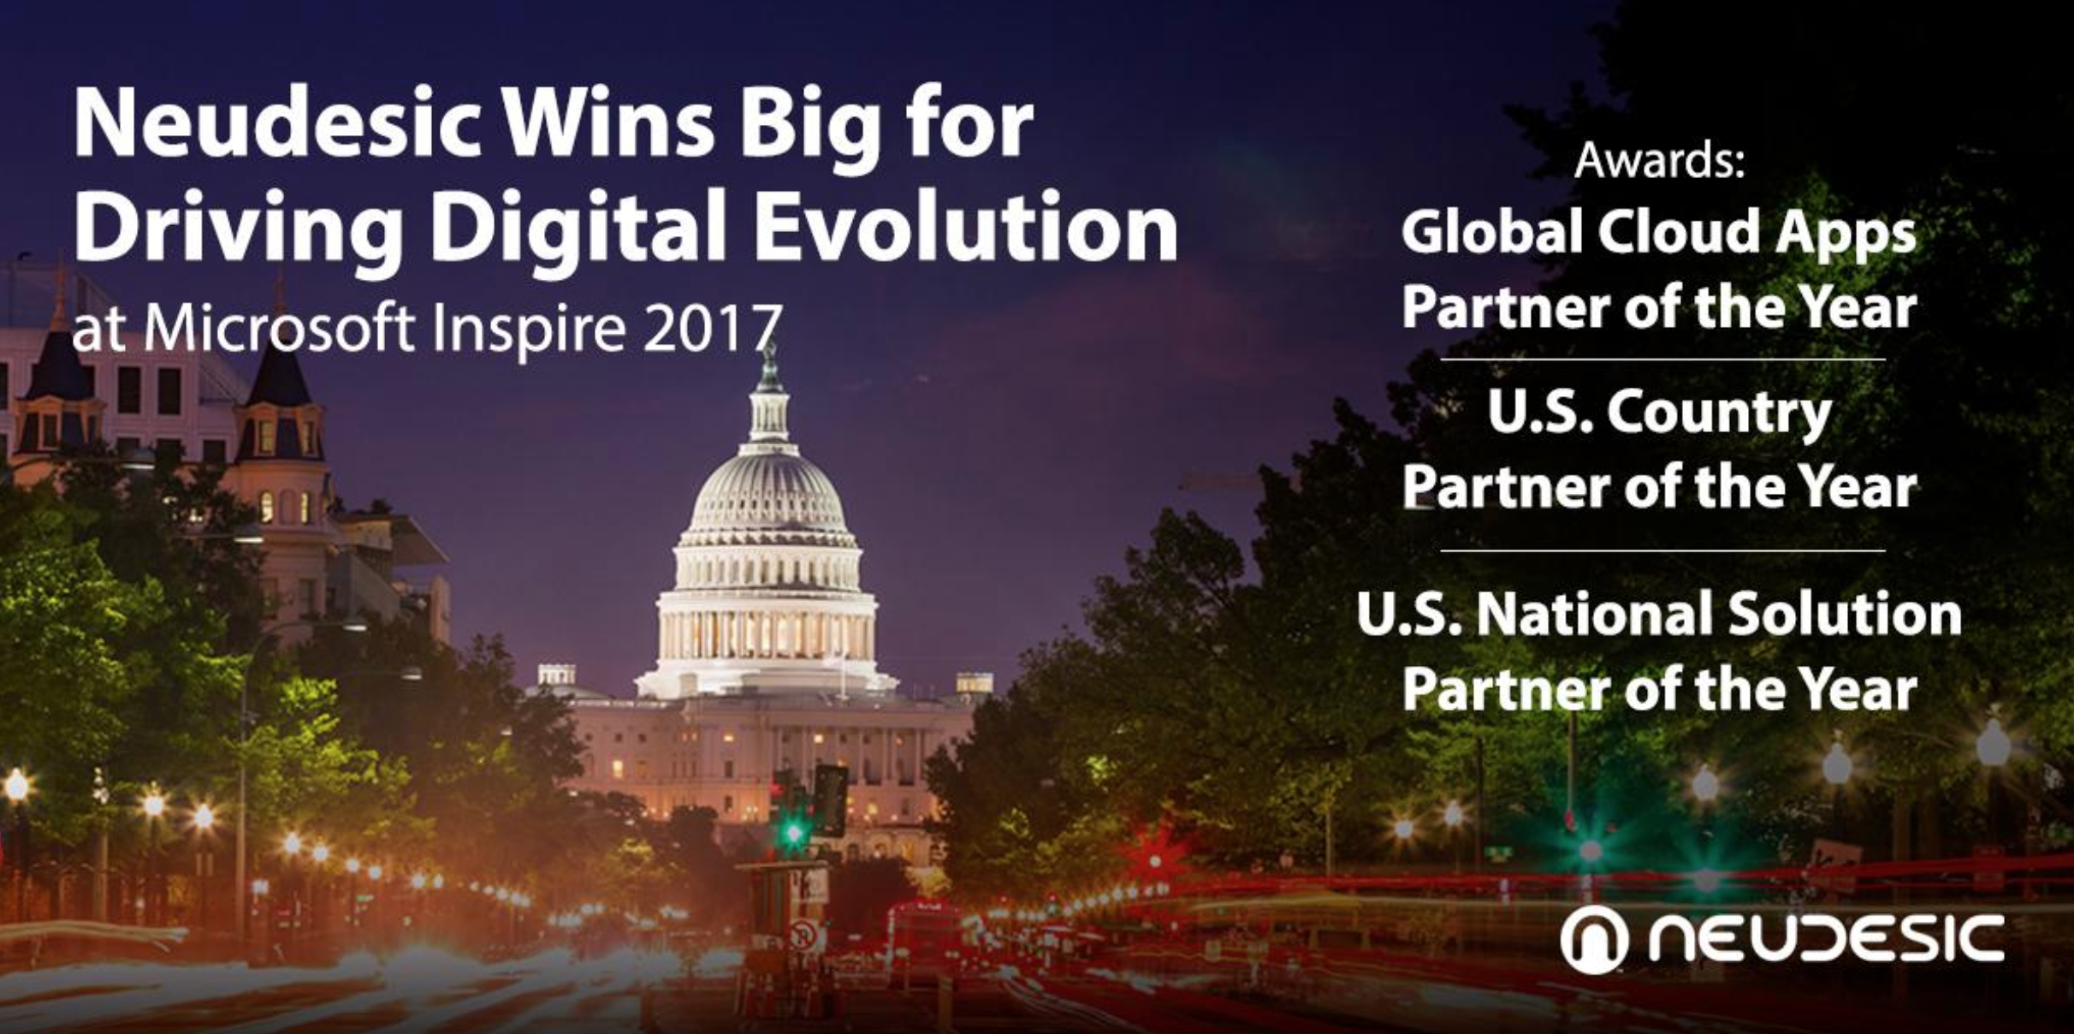
Notes:
Partner of the Year Slide

Slide 4




























OUR CLIENTS TRUST US TO INNOVATE

Slide 5



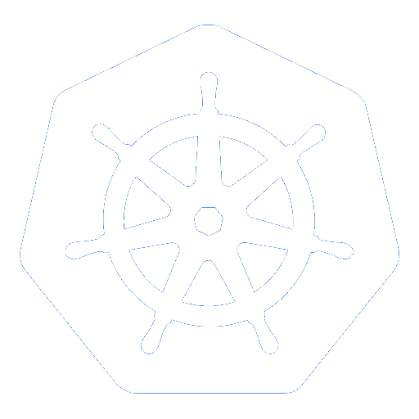
Containers on Azure
Azure Container Registry
Open source community
Azure Kubernetes Service (AKS)
Release automation tools
Containers 101
Azure container technology
Open Service Broker for Azure (OSBA)
Container orchestration
Azure Container Instances (ACI)

Slide 6
Containers 101
Azure Container Registry
Azure Kubernetes Service (AKS)
Release automation tools
Containers 101
Azure container technology
Open Service Broker for Azure (OSBA)
Container orchestration
Azure Container Instances (ACI)

Slide 7
Why should our business partners care about containers and microservices?

Slide 8
In reality, they shouldn’t…

Slide 9



They do care about innovation
“Unlimited” Scale
Global reach
Rapid innovation -> time to market
Notes:
IE – We don’t build cloud native, distributed apps just because it is “cool” and new. The business benefits are key

Slide 10
From traditional app to modern app
APP
Existing Application
Modern Infrastructure
rehost as VMs or refresh to modern container platform.
Containerize Applications
Re-architect apps for scale with containers.
Modern Microservices
Add new services or start peeling off services from monolithic code.
On-Premises
Infrastructure Platform
IaaS
Infrastructure Platform
“lift & shift”
Containers
Container Platform
PaaS
Application Platform
Serverless

Slide 11
What we hear from developers
I need to create applications at a competitive rate without worrying about IT
New applications run smoothly on my machine but malfunction on traditional IT servers
My productivity and application innovation become suspended when I have to wait on IT

Slide 12
What we hear from IT
I need to manage servers and maintain compliance with little disruption
I’m unsure of how to integrate unfamiliar applications, and I require help from developers
I’m unable to focus on both server protection and application compliance

Slide 13
What is a container?
Containers = operating system virtualization
Traditional virtual machines = hardware virtualization
Container
Container
Container
Application
VM
VM
VM
Applications
OS
App
App
App
Kernel
OS
OS
OS
OS
Hardware
Hardware

Slide 14
Virtualization versus containerization
Virtual machine
Container
Application XYZ
Application
App dependencies
Dependencies
Guest OS
C
C
C
C
C
VM
VM
VM
Dependency 1
Dependency 2
VM
VM
VM
Hypervisor 2
Docker Engine
Hypervisor 1
Host OS
Host OS
Hardware
Hardware
Hardware
Type 1
Type 2
Virtualization
Containerization

Slide 15
The container advantage
Traditional virtualized environment
VM
VM
Low utilization of container resources
Containerization of applications and their dependencies
Application
Con.
Con.
Application
Con.
Con.
Hypervisor 2
Host OS
Hardware

Slide 16
The container advantage
Containerized environment
Migrate containers and their dependencies to underutilized VMs for improved density and isolation
VM
VM
Con.
Con.
Decommission unused resources for efficiency gains and cost savings
Con.
Con.
Docker Engine
Host OS
Hardware

Slide 17

The container advantage
Fast iteration
Agile delivery
Immutability
Cost savings
Efficient deployment
Elastic bursting
For developers
For IT

Slide 18


Containers are gaining momentum
Does your organization currently use container technologies?¹
23%
My org. is evaluating container technologies
Yes, my org. currently uses container technologies
No, my org. is not using container technologies
Not sure
Not applicable
Larger companies are leading adoption.²
42%
~60%
25%
7%
Nearly 60% percent of organizations running 500 or more hosts are classiﬁed as container dabblers or adopters.
2%
The average company QUINTUPLES its container usage within 9 months.¹
Container hosts often run SEVEN containers at a time.¹
Containers churn 9 times FASTER than VMs.¹
5x
7x
9x
Source:
1: Datadog: 8 Surprising Facts About Real Docker Adoption; 2: DZone: The DZone Guide to Deploying and Orchestrating Containers

Slide 19


Industry analysts agree
“By 2020, more than 50% of enterprises will run mission-critical, containerized cloud-native applications in production, up from less than 5% today.”

Slide 20
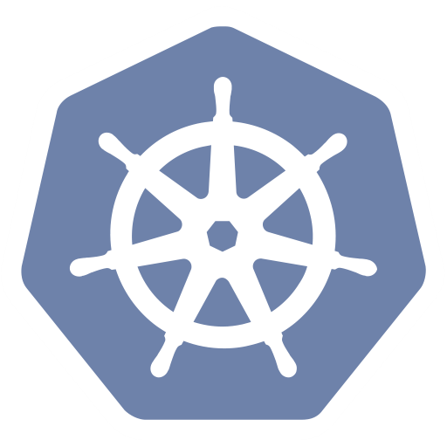
Container orchestration
Azure Container Registry
Azure Kubernetes Service (AKS)
Release automation tools
Containers 101
Azure container technology
Open Service Broker for Azure (OSBA)
Container orchestration
Azure Container Instances (ACI)

Slide 21
The elements of orchestration
Scheduling
Affinity/anti-affinity
Health monitoring
Failover
Scaling
Networking
Service discovery
Coordinated app upgrades

Slide 22
Kubernetes: the de-facto orchestrator
Portable
Public, private, hybrid, multi-cloud
Extensible
Modular, pluggable, hookable, composable
Self-healing
Auto-placement, auto-restart, auto-replication, auto-scaling

Slide 23
Kubernetes: empowering you to do more
Deploy your applications quickly and predictably
Scale your applications on the fly
Roll out new features seamlessly
Limit hardware usage to required resources only

Slide 24

“Distributed apps are sufficiently complicated that they need to be flown by the instruments”
Notes:
This is meant to highlight the need for advanced tooling and orchestration for highly complex distributed apps

Slide 25
Azure container technology
Azure Container Registry
Open source community
Azure Kubernetes Service (AKS)
Release automation tools
Containers 101
Getting started
Azure container technology
Open Service Broker for Azure (OSBA)
Customer success stories
Container orchestration
Azure Container Instances (ACI)

Slide 26
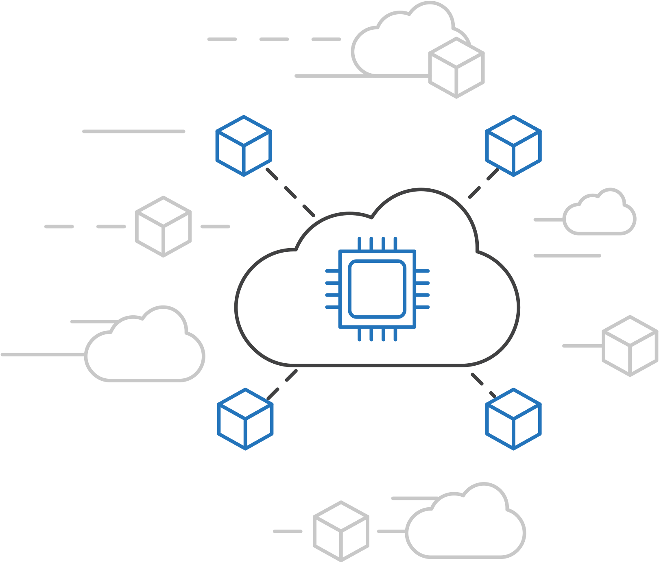
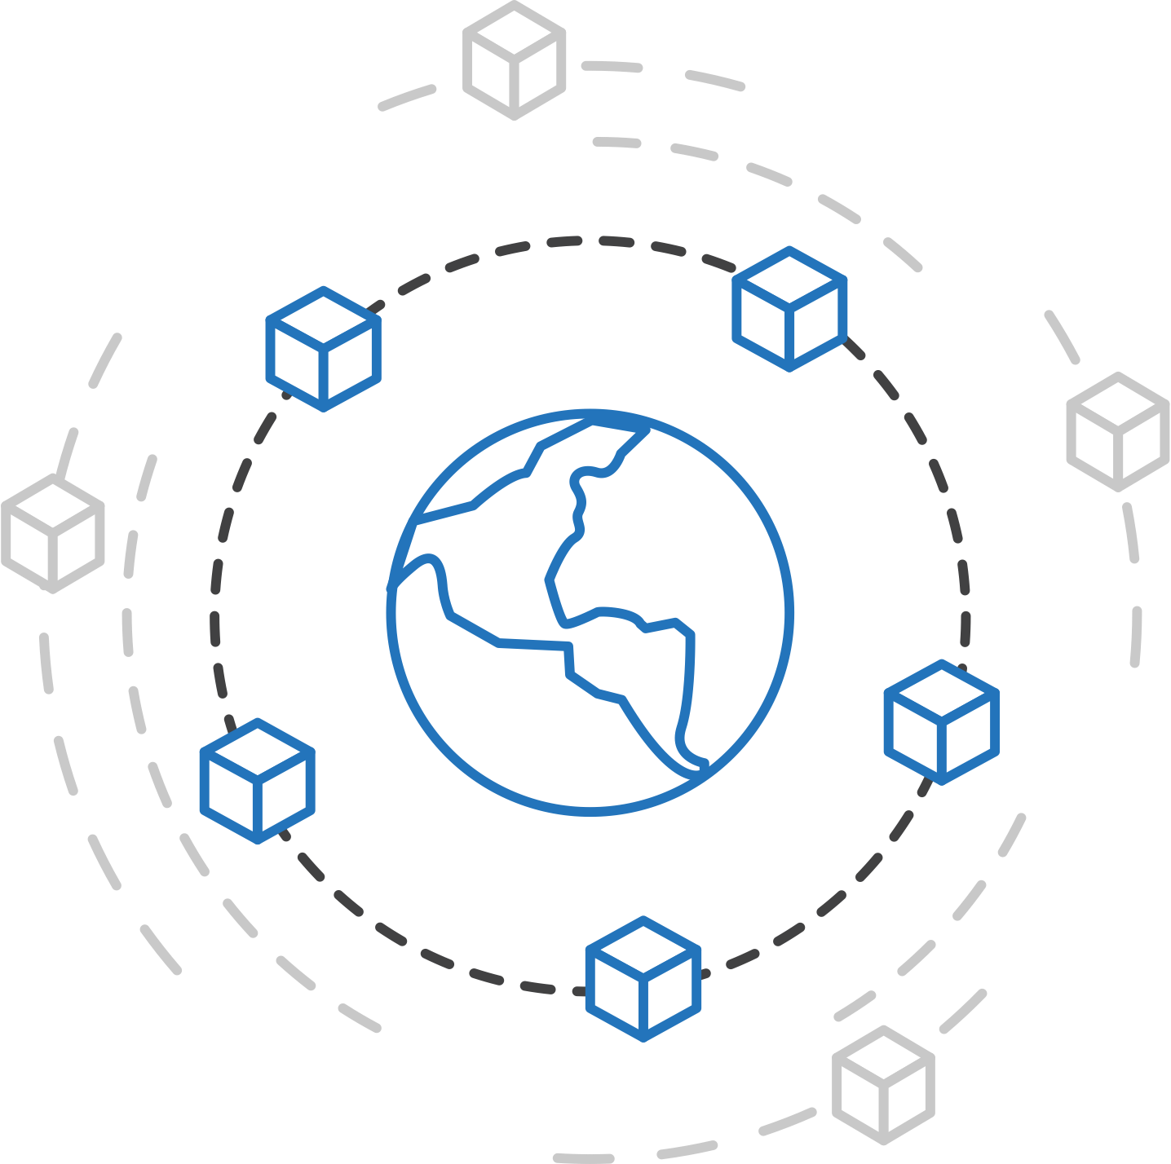
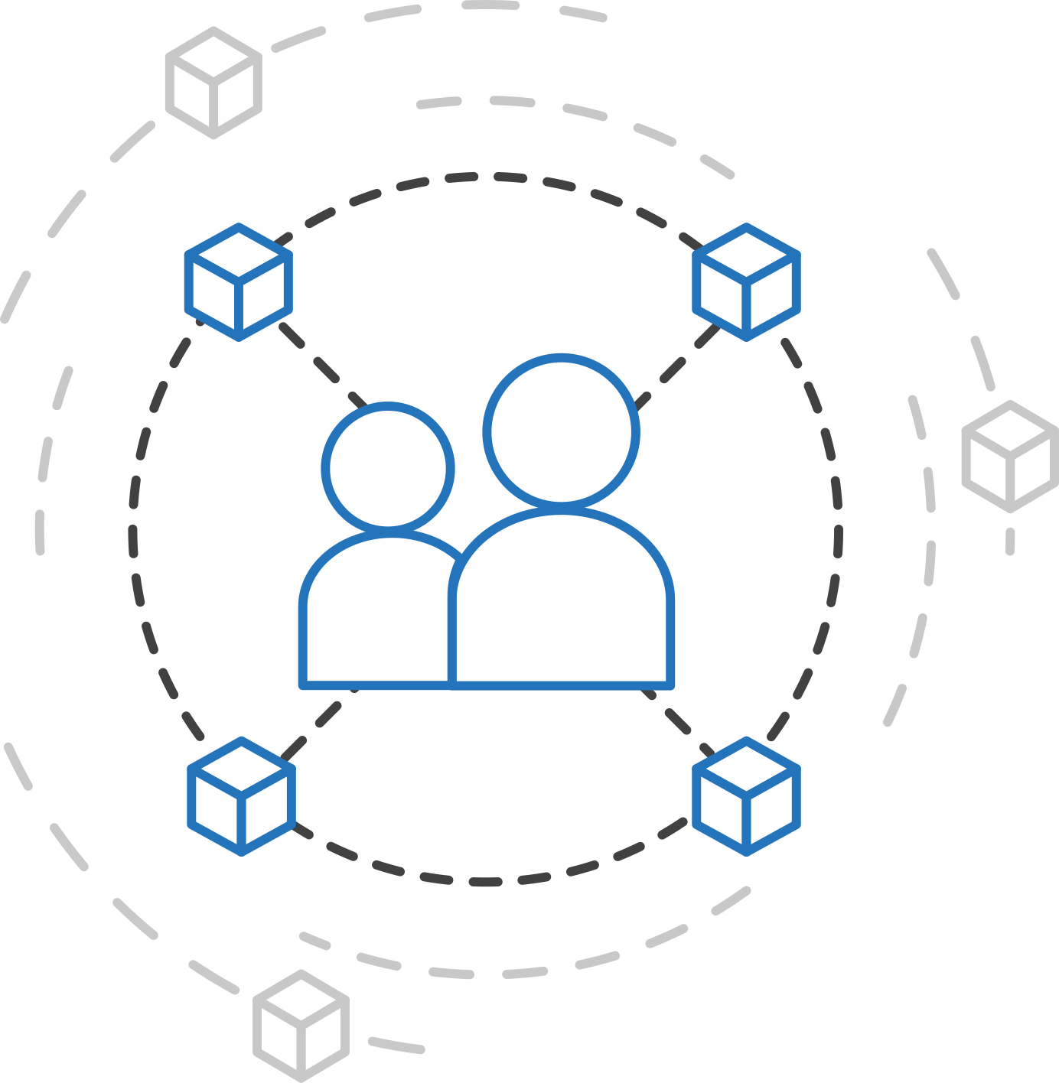
Azure container strategy
Embrace containers as ubiquitous
Support containers across the compute portfolio
Democratize container technology

Slide 27



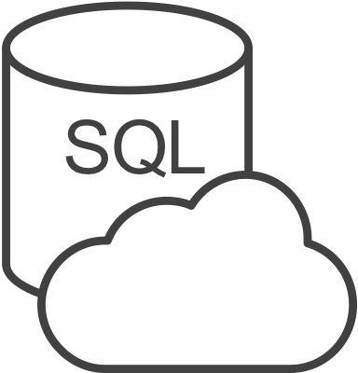



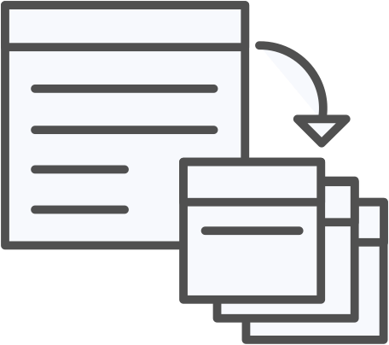



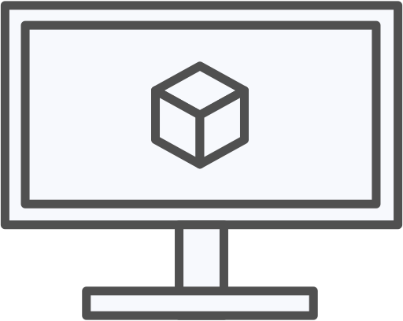
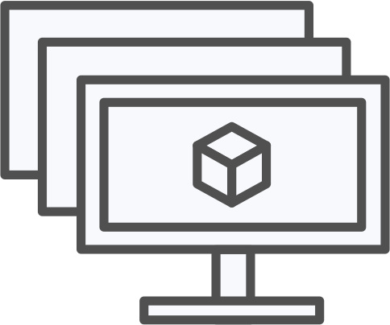
Azure container ecosystem
OSBA
App Service
Azure Container Registry (ACR)
Partner services
Azure services
PaaS
OpenShift
SQL Database
Azure Kubernetes Service (AKS)
Service Fabric
Batch
Pivotal Cloud Foundry
Redis Cache
ACS Engine
Docker Enterprise Edition
CosmosDB
Virtual kubelet
Mesosphere DC/OS
And more!
Azure Container Instances (ACI)
Azure Virtual Machines
Virtual Machine Scale Sets (VMSS)
Azure
IaaS

Slide 28
Azure Kubernetes Service (AKS)
Azure Container Registry
Open source community
Azure Kubernetes Service (AKS)
Release automation tools
Containers 101
Getting started
Azure container technology
Open Service Broker for Azure (OSBA)
Customer success stories
Container orchestration
Azure Container Instances (ACI)

Slide 29

Azure Kubernetes Service (AKS)
Azure Kubernetes Service (AKS)
OSBA
App Service
Azure Container Registry (ACR)
Azure Container Instances (ACI)
Partner services
Azure services
PaaS
OpenShift
SQL Database
Azure Kubernetes Service (AKS)
Service Fabric
Batch
Azure Container Registry
Pivotal Cloud Foundry
Redis Cache
ACS Engine
Docker Enterprise Edition
CosmosDB
Virtual kubelet
Open Service Broker API (OSBA)
Mesosphere DC/OS
And more!
Azure Container Instances (ACI)
Azure Virtual Machines
Virtual Machine Scale Sets (VMSS)
Azure
IaaS
Release Automation Tools

Slide 30
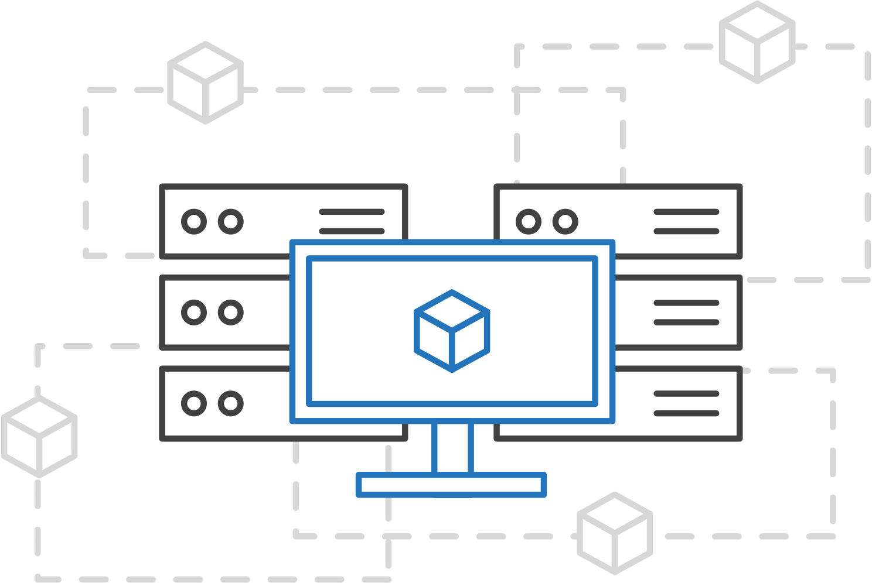
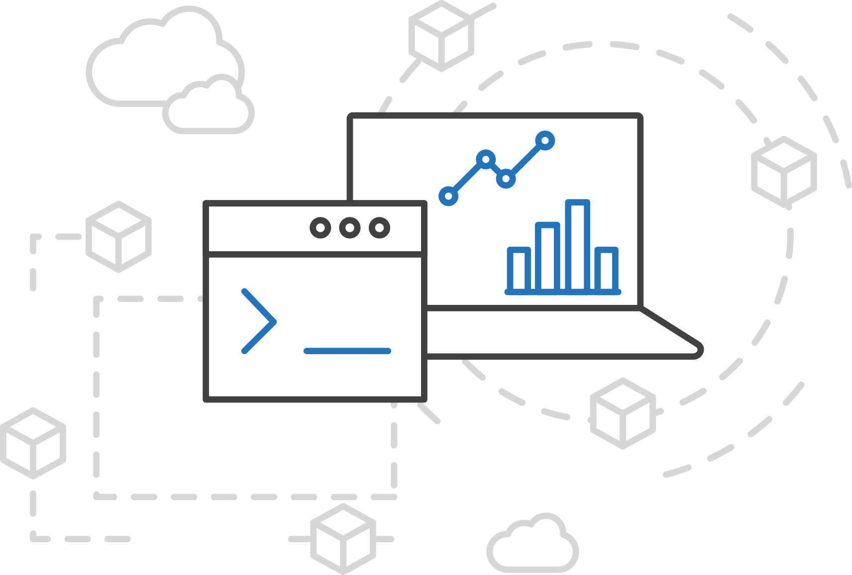
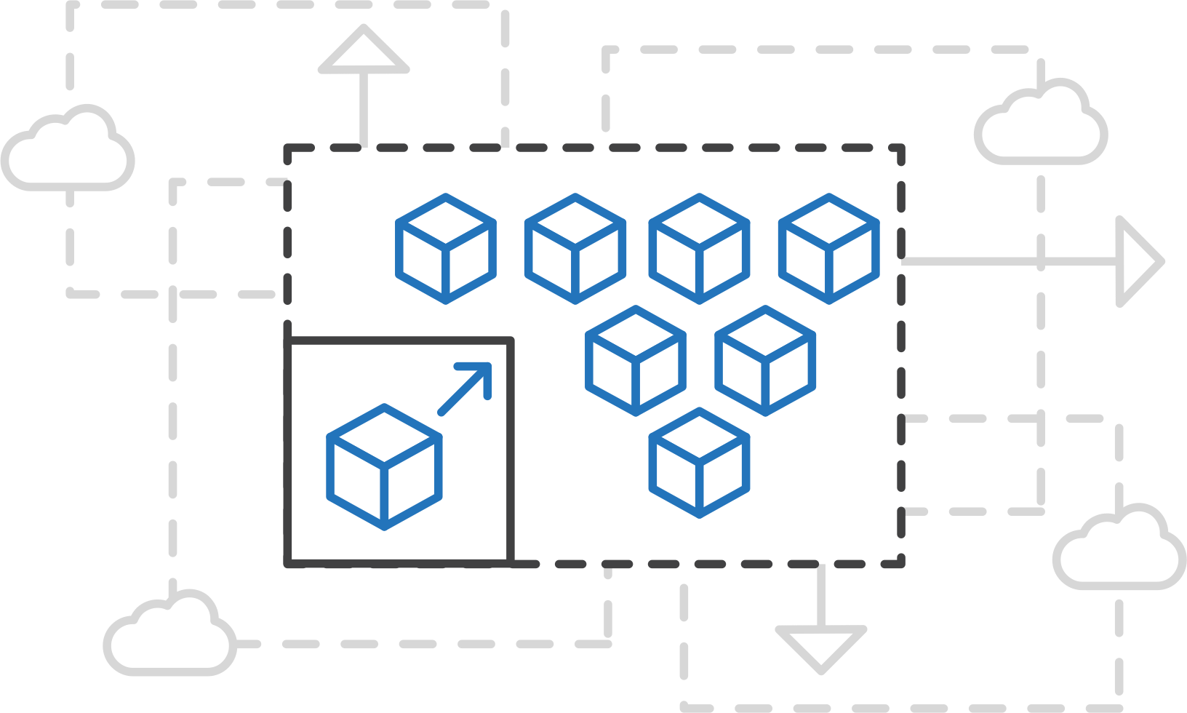
Azure Kubernetes Service (AKS)
Azure Kubernetes Service (AKS)
Simplify the deployment, management, and operations of Kubernetes
Azure Container Instances (ACI)
Azure Container Registry
Focus on your containers not the infrastructure
Work how you want with open-source APIs
Scale and run applications with confidence
Open Service Broker API (OSBA)
Release Automation Tools

Slide 31
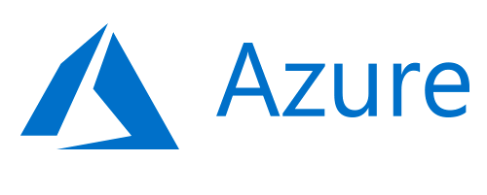
Azure Kubernetes Service (AKS)
Azure Kubernetes Service (AKS)
A fully managed Kubernetes cluster
Azure Container Instances (ACI)
Managed control pane
Automated upgrades, patches
Easy cluster scaling
Self-healing
Cost savings
Managed
Azure Container Registry
Application architect
Applications
Operations
Kubernetes
Open Service Broker API (OSBA)
Infrastructure architect
Docker
Azure infrastructure services
Release Automation Tools

Slide 32
Azure Kubernetes Service (AKS)
Azure Kubernetes Service (AKS)
Get started easily
Azure Container Instances (ACI)
$ az aks create -g myResourceGroup -n myCluster --generate-ssh-keys
\ Running ..
$ az aks install-cli
Downloading client to /usr/local/bin/kubectl ..
$ az aks get-credentials -g myResourceGroup -n myCluster
Merged "myCluster" as current context ..
$ kubectl get nodes
NAME STATUS AGE VERSION
aks-mycluster-36851231-0 Ready 4m v1.8.1
aks-mycluster-36851231-1 Ready 4m v1.8.1
aks-mycluster-36851231-2 Ready 4m v1.8.1
Azure Container Registry
Open Service Broker API (OSBA)
Release Automation Tools

Slide 33
Azure Kubernetes Service (AKS)
Azure Kubernetes Service (AKS)
Manage an AKS cluster
Azure Container Instances (ACI)
$ az aks list –o table
Name Location ResourceGroup KubernetesRelease ProvisioningState
------------------ ---------- -------------- ------------------- -------------------
myCluster westus2 myResourceGroup 1.7.7 Succeeded
$ az aks upgrade -g myResourceGroup -n myCluster –-kubernetes-version 1.8.1
\ Running ..
$ kubectl get nodes
NAME STATUS AGE VERSION
aks-mycluster-36851231-0 Ready 12m v1.8.1
aks-mycluster-36851231-1 Ready 8m v1.8.1
aks-mycluster-36851231-2 Ready 3m v1.8.1
$ az aks scale -g myResourceGroup -n myCluster --agent-count 10
\ Running ..
Azure Container Registry
Open Service Broker API (OSBA)
Release Automation Tools

Slide 34
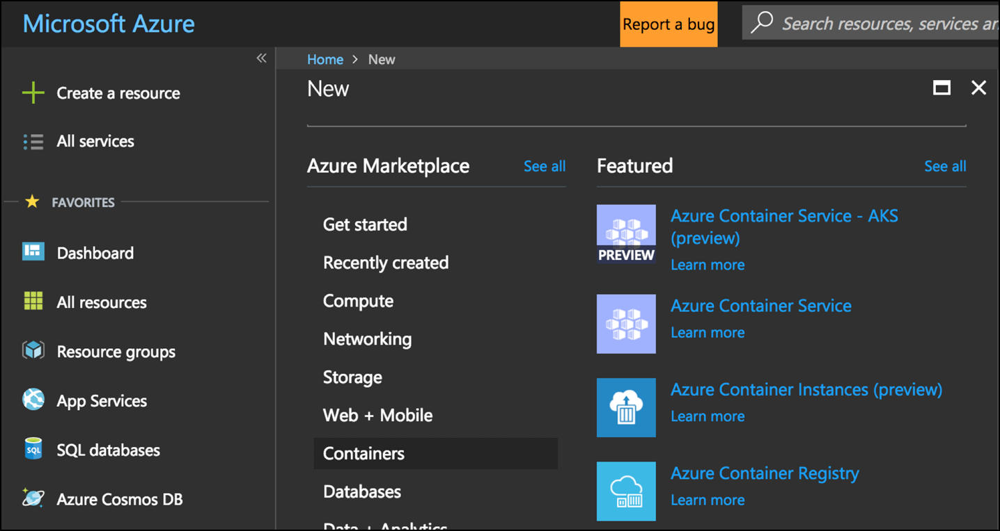
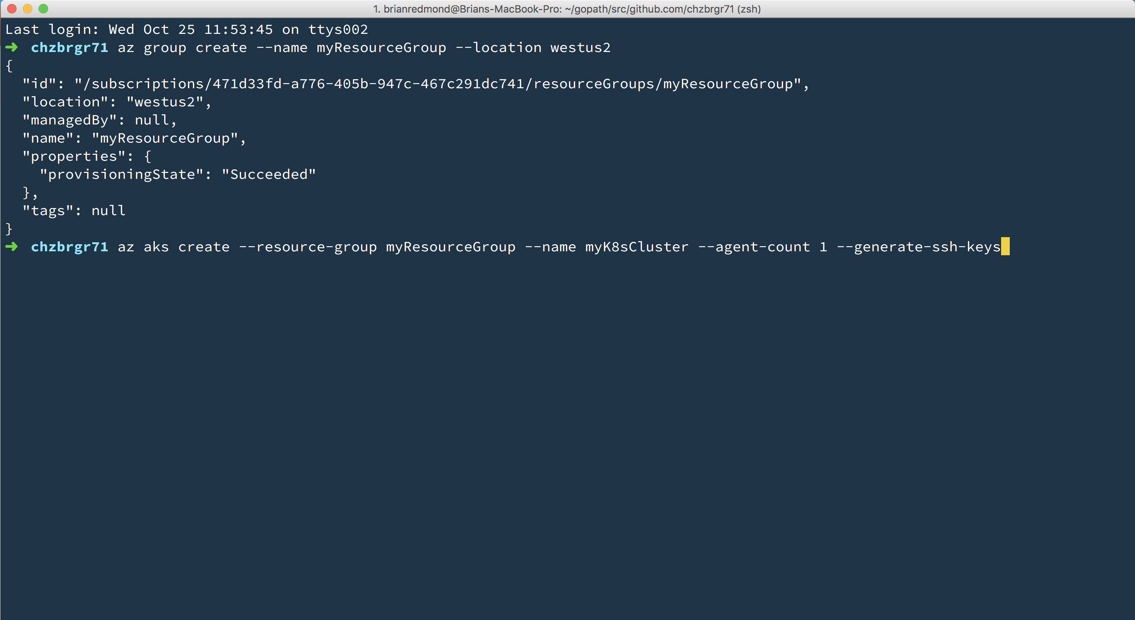
Azure Kubernetes Service (AKS)
Azure Kubernetes Service (AKS)
Create AKS via Portal, Azure CLI, or ARM template
Azure Container Instances (ACI)
Azure Container Registry
Open Service Broker API (OSBA)
Release Automation Tools

Slide 35
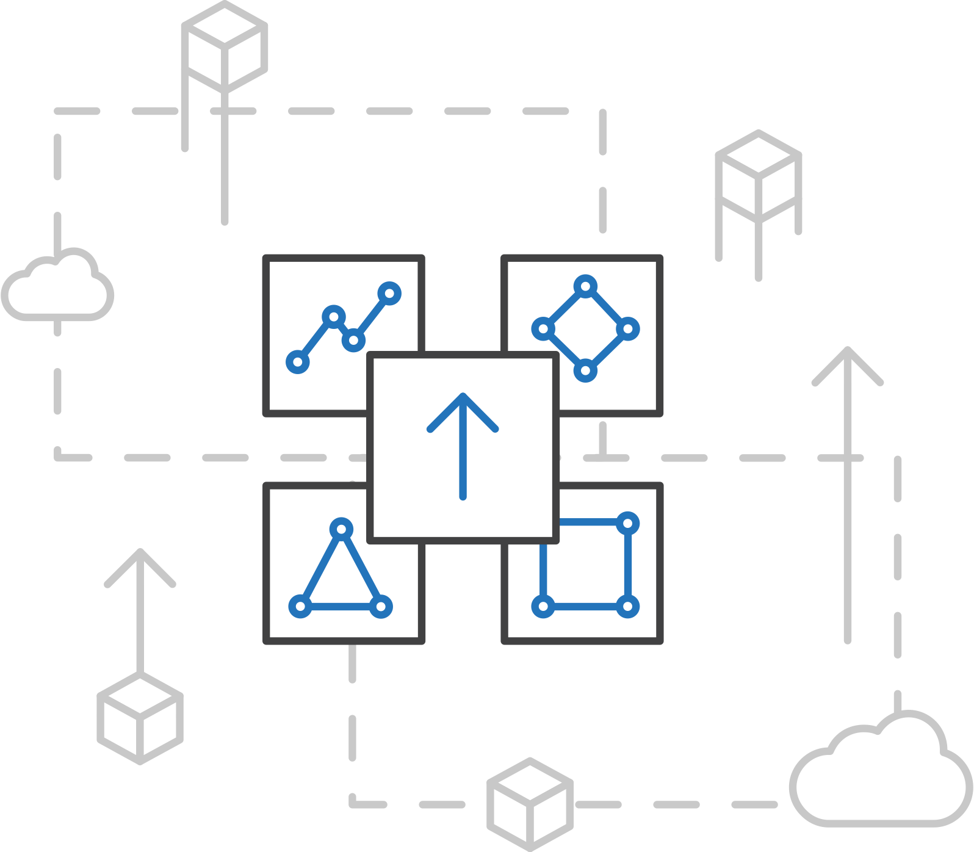
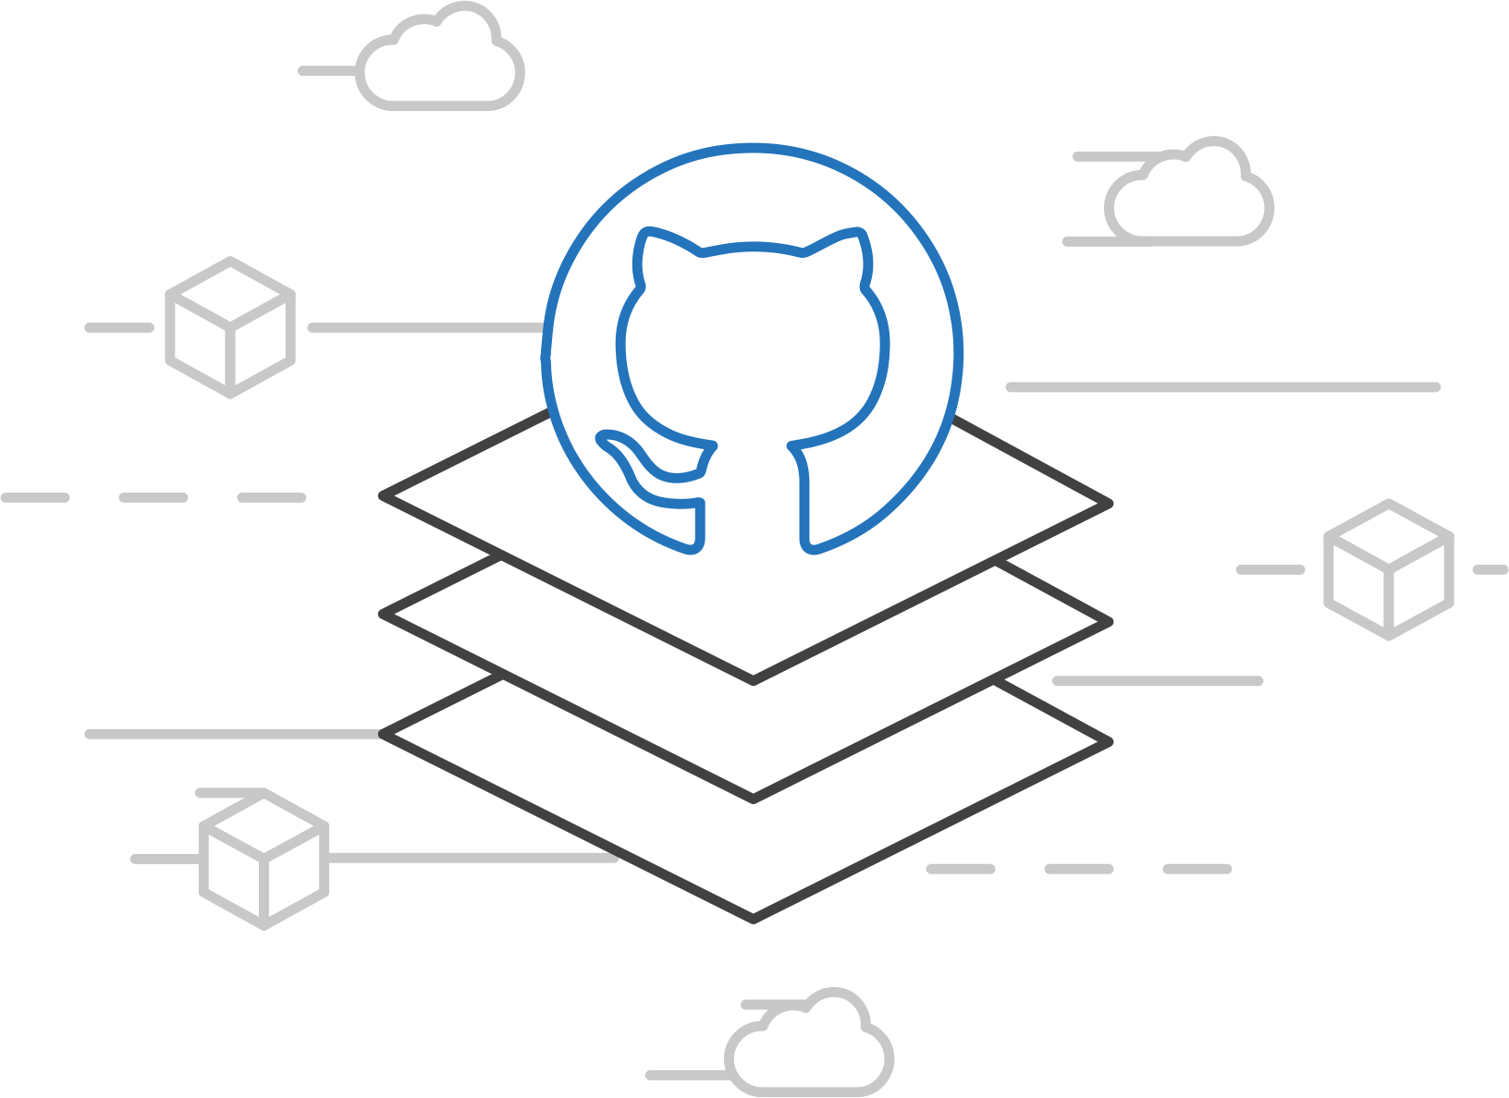
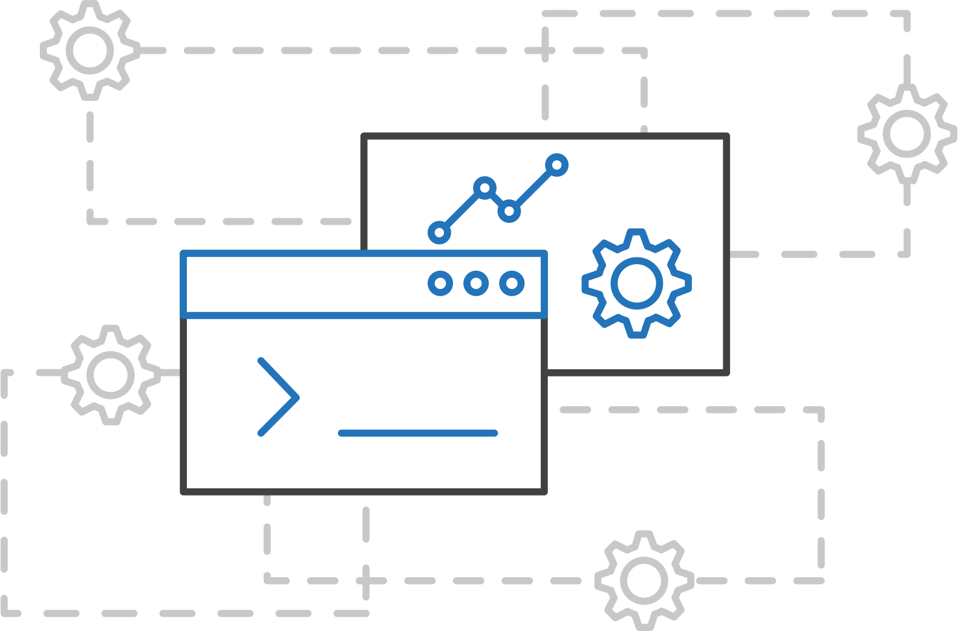
ACS Engine
Azure Kubernetes Service (AKS)
Customized Kubernetes on Azure
Azure Container Instances (ACI)
Azure Container Registry
Open Service Broker API (OSBA)
A proving ground for new features
Enables custom deployments
Available on GitHub
Release Automation Tools

Slide 36
Azure Container Instances (ACI)
Azure Container Registry
Open source community
Azure Kubernetes Service (AKS)
Release automation tools
Containers 101
Getting started
Azure container technology
Open Service Broker for Azure (OSBA)
Customer success stories
Container orchestration
Azure Container Instances (ACI)

Slide 37
Azure Container Instances (ACI)
PREVIEW
Azure Kubernetes Service (AKS)
OSBA
App Service
Azure Container Registry (ACR)
Azure Container Instances (ACI)
Partner services
Azure services
PaaS
OpenShift
SQL Database
Azure Kubernetes Service (AKS)
Service Fabric
Batch
Azure Container Registry
Pivotal Cloud Foundry
Redis Cache
ACS Engine
Docker Enterprise Edition
CosmosDB
Virtual kubelet
Open Service Broker API (OSBA)
Mesosphere DC/OS
And more!
Azure Container Instances (ACI)
Azure Virtual Machines
Virtual Machine Scale Sets (VMSS)
Azure
IaaS
Release Automation Tools

Slide 38
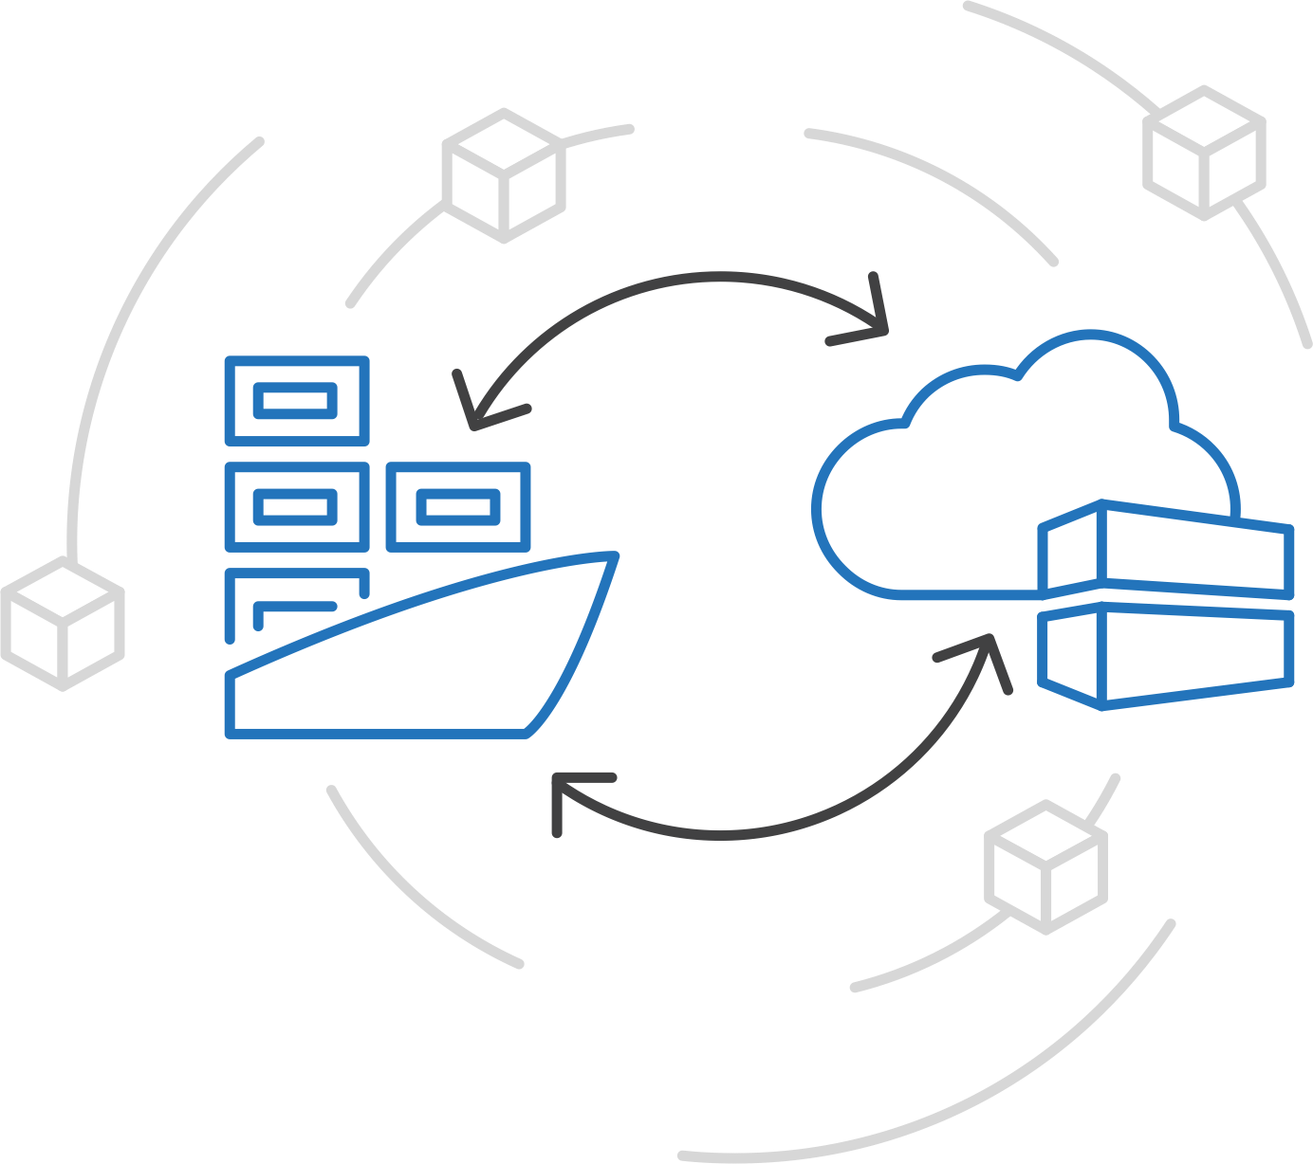
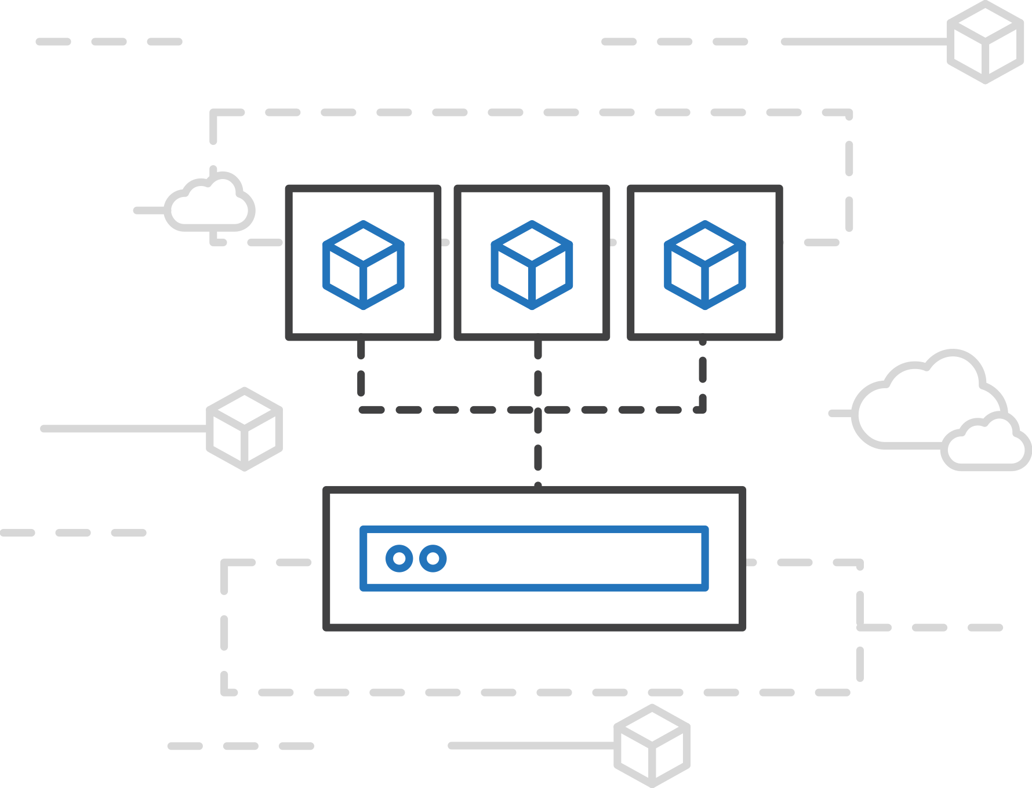
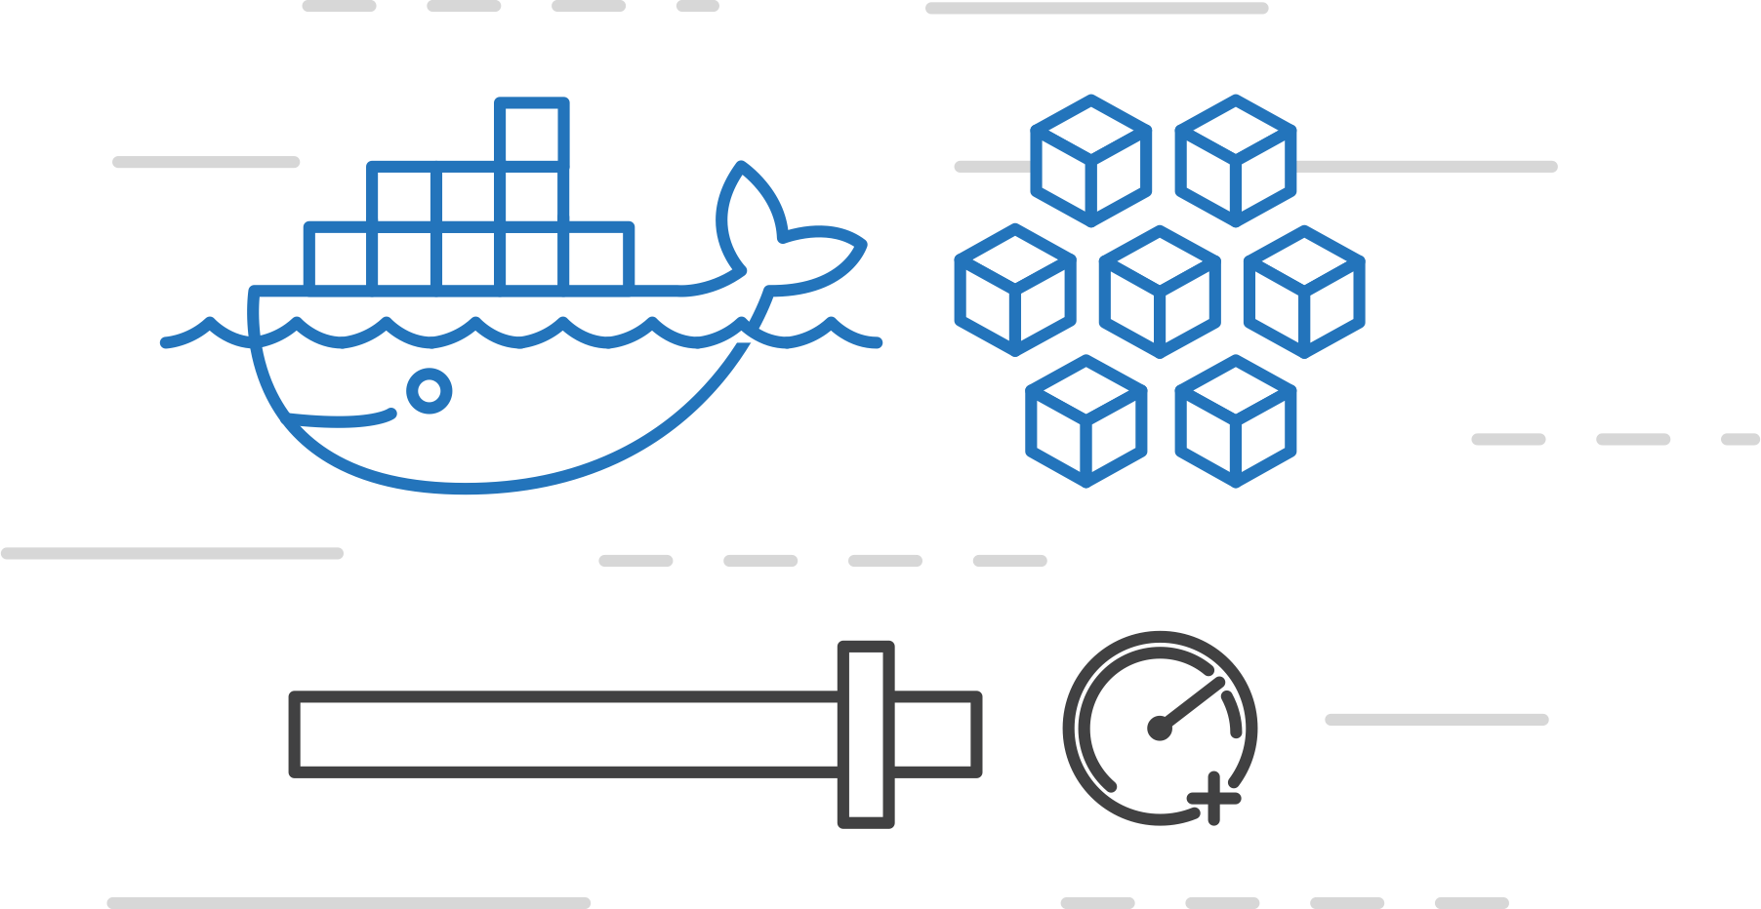
Azure Container Instances (ACI)
PREVIEW
Azure Kubernetes Service (AKS)
Easily run containers on Azure with a single command
Azure Container Instances (ACI)
Azure Container Registry
Start using containers right away
Cloud-scale container capacity
Hyper-visor isolation
Open Service Broker API (OSBA)
Release Automation Tools

Slide 39
Azure Container Instances (ACI)
PREVIEW
Azure Kubernetes Service (AKS)
Get started easily
Azure Container Instances (ACI)
$ az container create --name mycontainer --image microsoft/aci-helloworld --resource-group myResourceGroup --ip-address public
"ipAddress": {
"ip": "52.168.86.133",
"ports": [...]
},
"location": "eastus",
"name": "mycontainer",
"osType": "Linux",
"provisioningState": "Succeeded",
$ curl 52.168.86.133
<html>
<head>
<title>Welcome to Azure Container Instances!</title>
</head>
Azure Container Registry
Open Service Broker API (OSBA)
Release Automation Tools

Slide 40
Azure Container Instances (ACI)
PREVIEW
Azure Kubernetes Service (AKS)
Create an Azure Container Instance quickly
Azure Container Instances (ACI)
Azure Container Registry
Open Service Broker API (OSBA)
Release Automation Tools

Slide 41
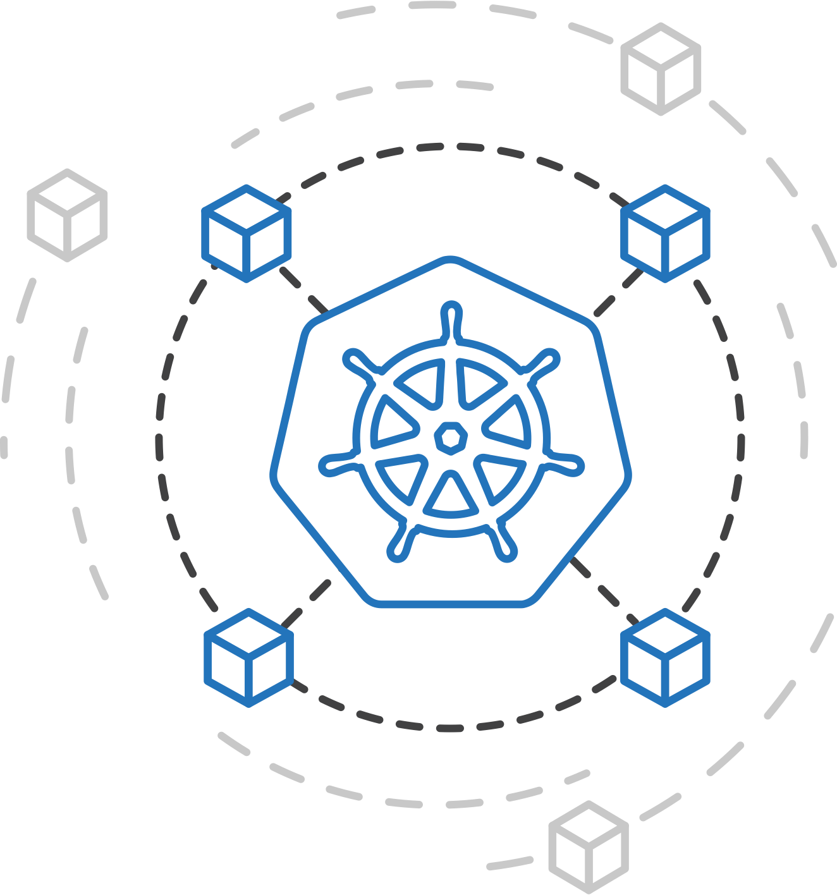
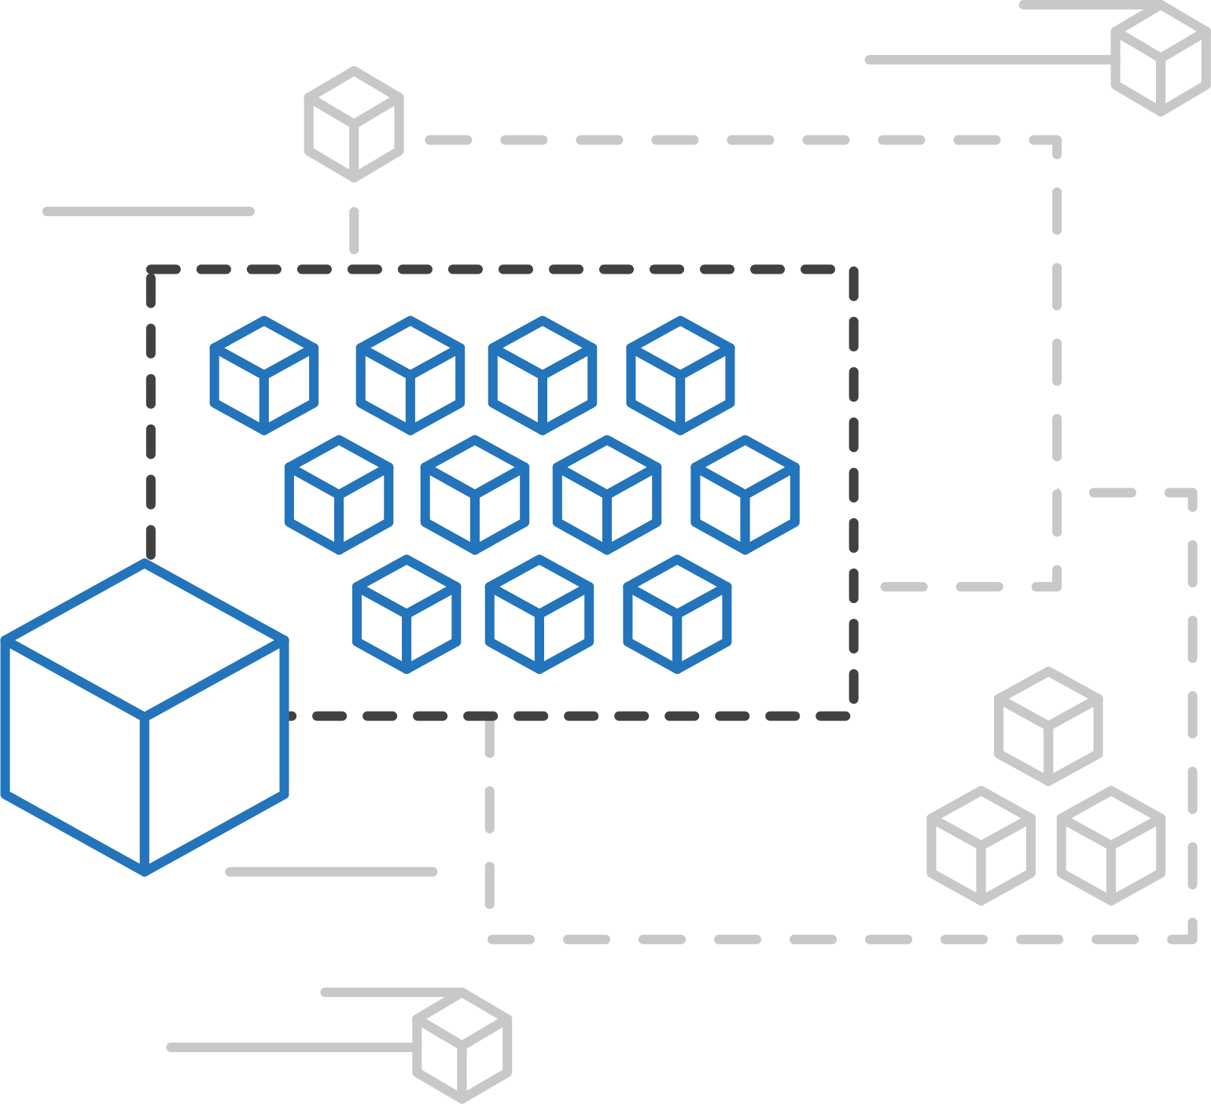
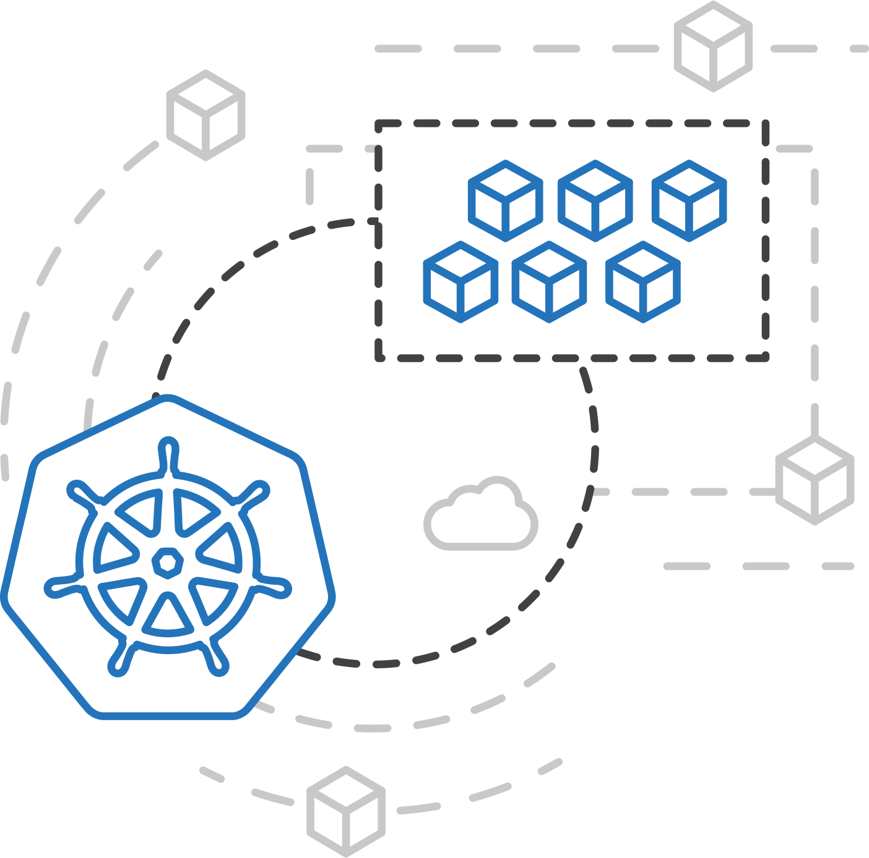
Azure Container Instances (ACI)
PREVIEW
Azure Kubernetes Service (AKS)
ACI Connector for Kubernetes
Azure Container Instances (ACI)
Azure Container Registry
Open Service Broker API (OSBA)
Kubernetes provides rich orchestration capabilities
ACI provides infinite container-based scale
The ACI Connector for K8s brings them together
Release Automation Tools

Slide 42
Azure Container Instances (ACI)
PREVIEW
Azure Kubernetes Service (AKS)
Bursting with the ACI Connector
VM
VM
Azure Container Instances (ACI)
Pod
Waste
Pod
Pod
Pod
Waste
Pod
Pod
Pod
Pod
Pod
Pod
Pod
Pod
Pod
Azure Container Registry
Application architect
Pod
Pod
Pod
Pod
Pod
ACI Connector
Pod
Pod
Pod
Pod
Pod
Kubernetes control pane
Deployment/ tasks
Pod
Pod
Pod
Pod
Pod
Open Service Broker API (OSBA)
Pod
Pod
Pod
Pod
Pod
Azure Container Instances (ACI)
Infrastructure architect
Pod
Waste
Pod
Pod
Pod
Waste
Pod
Pod
Pod
Pod
Release Automation Tools
VM
VM

Slide 43
Azure Container Instances (ACI)
PREVIEW
Azure Kubernetes Service (AKS)
Virtual Kubelet
Azure Container Instances (ACI)
Kubernetes API
Azure Container Registry
Kubelet
Kubelet
Kubelet
Kubelet
virtual kubelet
Node
Node
Node
Node
Open Service Broker API (OSBA)
Typical kubelets implement the pod and container operations for each node as usual.
Virtual kublet registers itself as a “node” and allows developers to program their own behaviors for operations on pods and containers.
Release Automation Tools

Slide 44
Azure Container Registry
Azure Container Registry
Open source community
Azure Kubernetes Service (AKS)
Release automation tools
Containers 101
Getting started
Azure container technology
Open Service Broker for Azure (OSBA)
Customer success stories
Container orchestration
Azure Container Instances (ACI)

Slide 45
Azure Container Registry
Azure Kubernetes Service (AKS)
OSBA
App Service
Azure Container Registry (ACR)
Azure Container Instances (ACI)
Partner services
Azure services
PaaS
OpenShift
SQL Database
Azure Kubernetes Service (AKS)
Service Fabric
Batch
Azure Container Registry
Pivotal Cloud Foundry
Redis Cache
ACS Engine
Docker Enterprise Edition
CosmosDB
Virtual kubelet
Open Service Broker API (OSBA)
Mesosphere DC/OS
And more!
Azure Container Instances (ACI)
Azure Virtual Machines
Virtual Machine Scale Sets (VMSS)
Azure
IaaS
Release Automation Tools

Slide 46
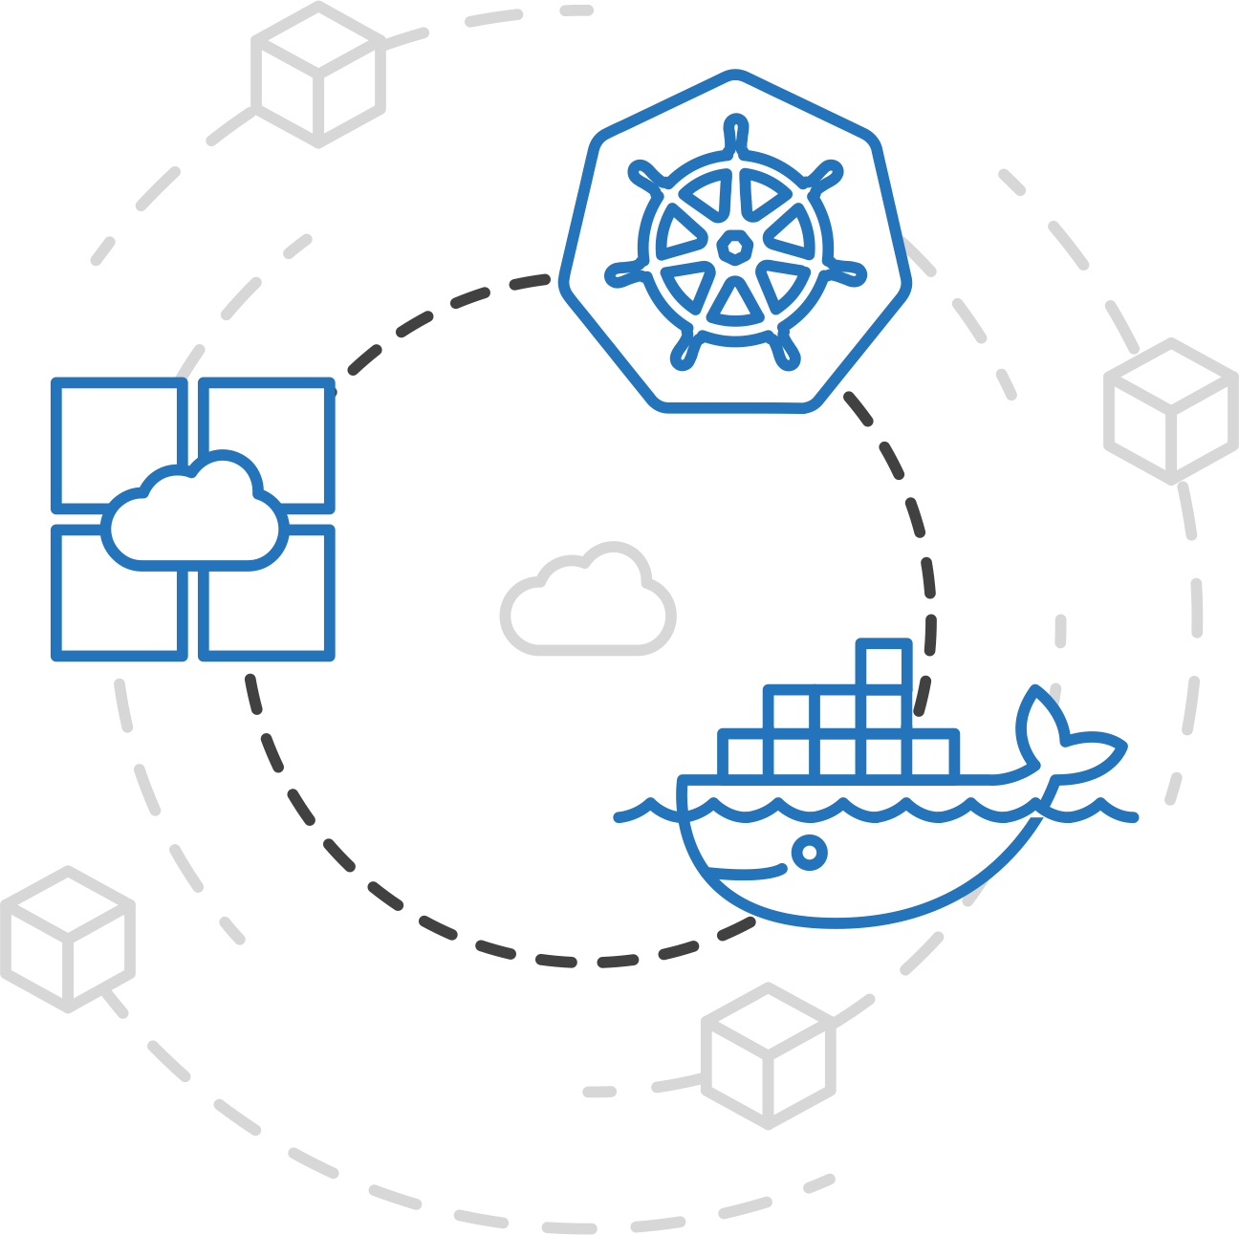

Azure Container Registry
Azure Kubernetes Service (AKS)
Manage a Docker private registry as a first-class Azure resource
Azure Container Instances (ACI)
Azure Container Registry
Open Service Broker API (OSBA)
Manage images for all types of containers
Use familiar, open-source Docker CLI tools
Azure Container Registry geo-replication
Release Automation Tools

Slide 47
Azure Container Registry
Azure Kubernetes Service (AKS)
Create a container in the Registry quickly
Azure Container Instances (ACI)
Azure Container Registry
Open Service Broker API (OSBA)
Release Automation Tools

Slide 48

Open Service Broker for Azure
Azure Container Registry
Open source community
Azure Kubernetes Service (AKS)
Release automation tools
Containers 101
Getting started
Azure container technology
Open Service Broker for Azure (OSBA)
Customer success stories
Container orchestration
Azure Container Instances (ACI)

Slide 49

Open Service Broker for Azure (OSBA)
Azure Kubernetes Service (AKS)
OSBA
App Service
Azure Container Registry (ACR)
Azure Container Instances (ACI)
Partner services
Azure services
PaaS
OpenShift
SQL Database
Azure Kubernetes Service (AKS)
Service Fabric
Batch
Azure Container Registry
Pivotal Cloud Foundry
Redis Cache
ACS Engine
Docker Enterprise Edition
CosmosDB
Virtual kubelet
Open Service Broker API (OSBA)
Mesosphere DC/OS
Azure Container Instances (ACI)
Azure Virtual Machines
Virtual Machine Scale Sets (VMSS)
And more!
Azure
IaaS
Release Automation Tools

Slide 50
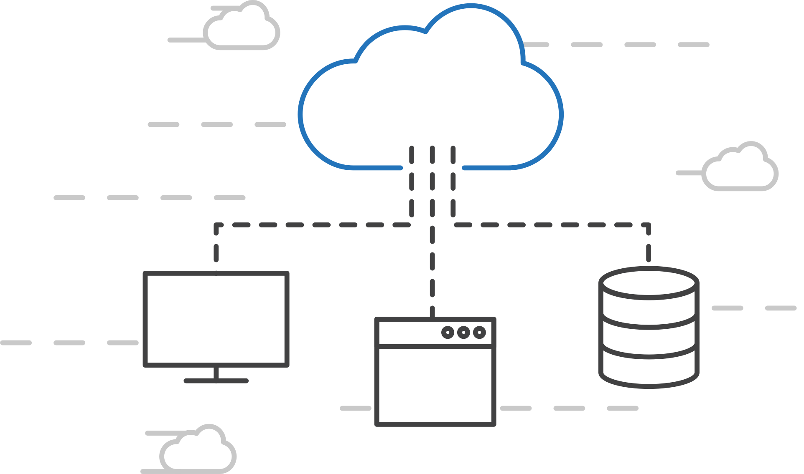
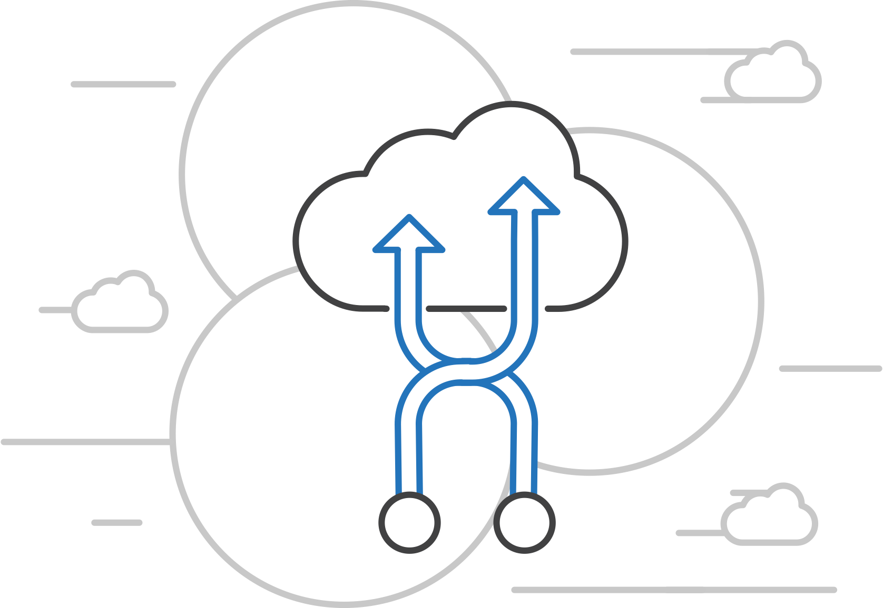
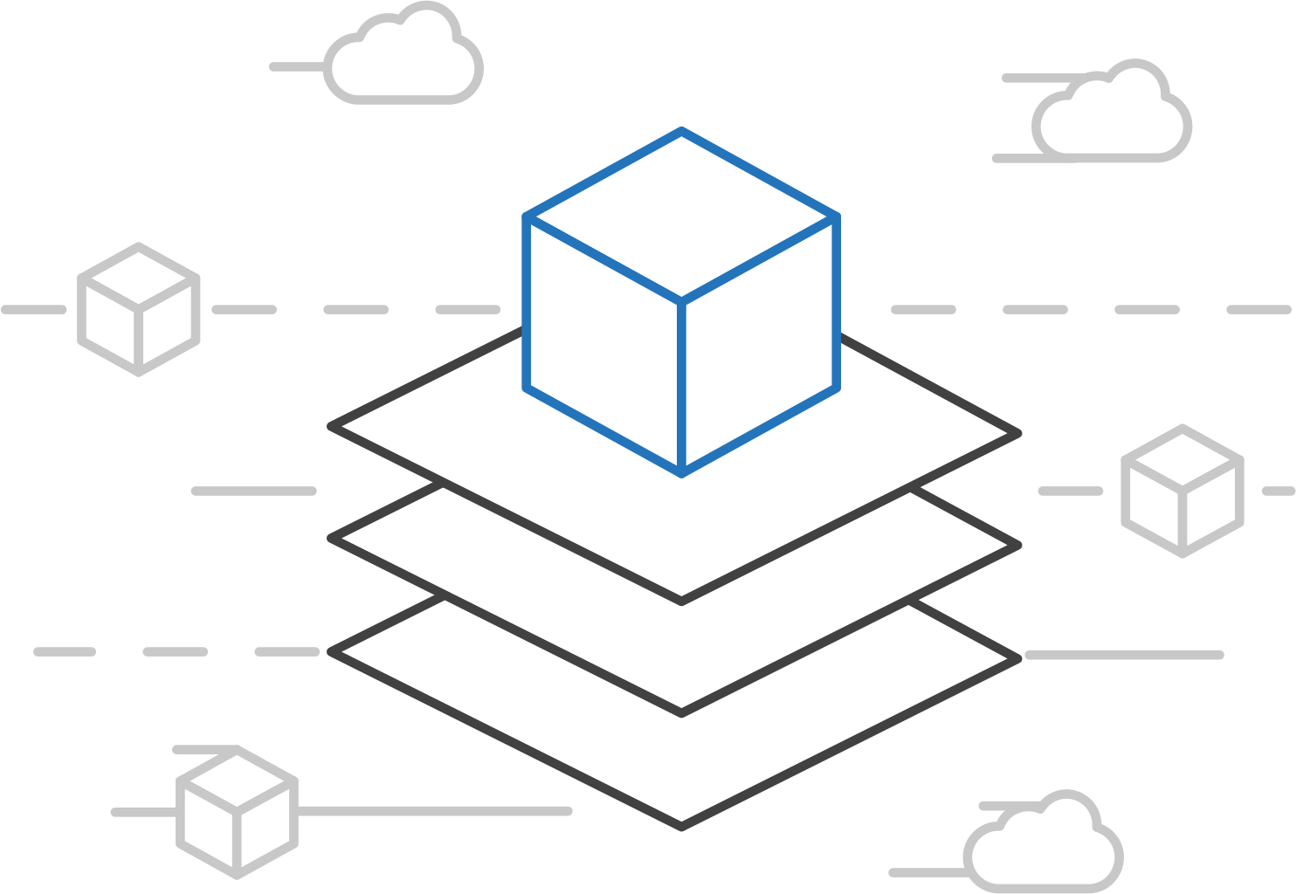
Open Service Broker for Azure (OSBA)
Azure Kubernetes Service (AKS)
Connecting containers to Azure services and platforms
Azure Container Instances (ACI)
Azure Container Registry
A standardized way to connect with Azure services
Simple and flexible service integration
Compatible across numerous platforms
Open Service Broker API (OSBA)
Release Automation Tools

Slide 51
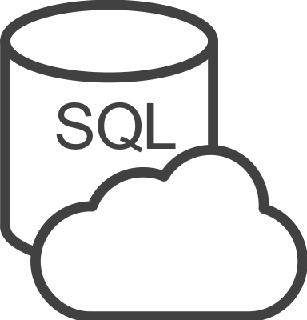




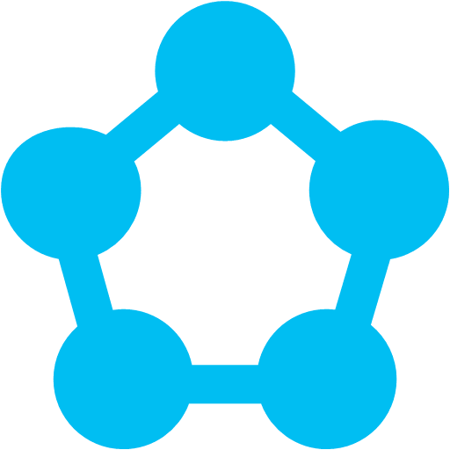
Open Service Broker for Azure (OSBA)
Azure Kubernetes Service (AKS)
An implementation of the Open Service Broker API
Azure SQL Database
Redis Cache
CosmosDB
And more!
Azure Container Instances (ACI)
Azure Container Registry
Open Service Broker for Azure (OSBA)
Open Service Broker API (OSBA)
OpenShift
Cloud Foundry
Service Fabric (Coming soon)
Kubernetes (AKS)
Release Automation Tools

Slide 52
Open Service Broker for Azure (OSBA)
Azure Kubernetes Service (AKS)
Getting started with ease
Azure Container Instances (ACI)
$ helm repo add azure Azure/helm-charts
$ helm install azure/service-broker
$ helm install azure/wordpress
Azure Container Registry
Open Service Broker API (OSBA)
Release Automation Tools

Slide 53
Release automation tools
Azure Container Registry
Open source community
Azure Kubernetes Service (AKS)
Release automation tools
Containers 101
Getting started
Azure container technology
Open Service Broker for Azure (OSBA)
Customer success stories
Container orchestration
Azure Container Instances (ACI)

Slide 54
DevOps Practices Arrive
Developers: Test, Build, Code, Plan
Operations: Monitor, Release, Deploy, Operate
DevOps Features
Speed of application delivery/updates
Faster time to value
Repeatable/consistent
Automated testing
Traceability of process
Applying developer patterns to infrastructure
Infrastructure as code
Ops teams embracing source control
Centralized monitoring, logging, debugging
CI / CD – key aspect of quality DevOps

Slide 55
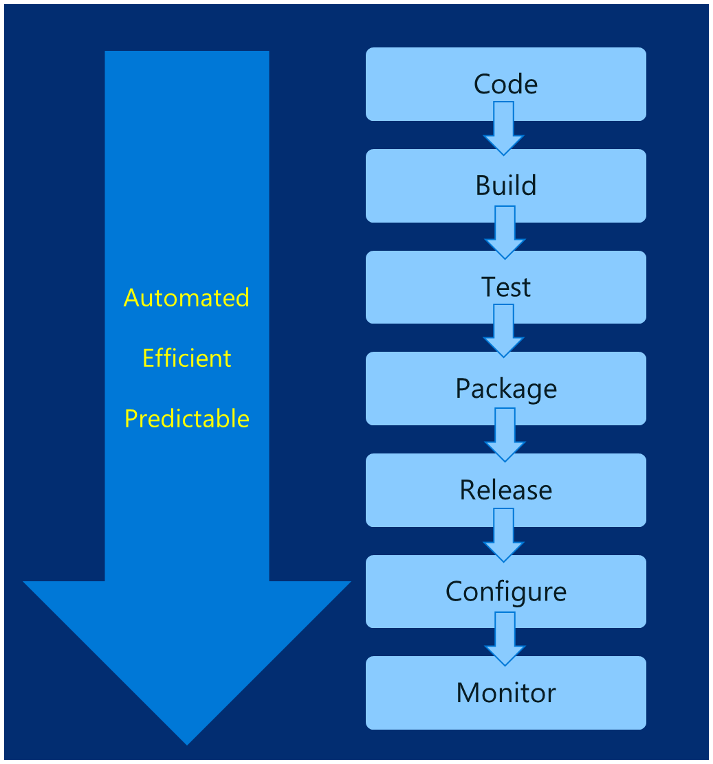
DevOps – Why?
Deploy 200 times more frequently
Go from code check-in to production 2,555 times faster
Recover from failure 24 times faster
Spent 50% less time remediating security challenges
Spent 22% less time on unplanned work
2.2 times more likely to believe their places a great place to work
Source: https://puppet.com/resources/white-paper/2016-state-of-devops-report

Slide 56
Common Toolsets
Jenkins
Visual Studio Team Services
Spinnaker and Netflix OSS
Travis
TeamCity
CircleCI
Additional utilities: code quality scanning, security, collaboration, etc.

Slide 57

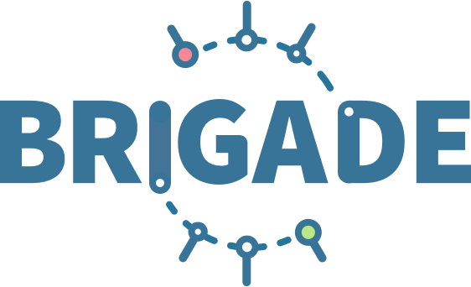


Release automation tools
Azure Kubernetes Service (AKS)
Simplifying the Kubernetes experience
Azure Container Instances (ACI)
Azure Container Registry
Streamlined Kubernetes development
The package manager for Kubernetes
Event-driven scripting for Kubernetes
Visualization dashboard for Brigade
Open Service Broker API (OSBA)
Release Automation Tools

Slide 58

Draft
Azure Kubernetes Service (AKS)
Simple app development and deployment – into any Kubernetes cluster
Azure Container Instances (ACI)
Azure Container Registry
Simplified development
Using two simple commands, developers can now begin hacking on container-based applications without requiring Docker or even installing Kubernetes themselves
Language support
Draft detects which language your app is written in, and then uses packs to generate a Dockerfile and Helm Chart with the best practices for that language
Open Service Broker API (OSBA)
Release Automation Tools

Slide 59
Helm
Azure Kubernetes Service (AKS)
The best way to find, share, and use software built for Kubernetes
Azure Container Instances (ACI)
Azure Container Registry
Manage complexity
Charts can describe complex apps; provide repeatable app installs, and serve as a single point of authority
Easy updates
Take the pain out of updates with in-place upgrades and custom hooks
Simple sharing
Charts are easy to version, share, and host on public or private servers
Rollbacks
Use helm rollout to roll back to an older version of a release with ease
Open Service Broker API (OSBA)
Release Automation Tools

Slide 60

Helm
Azure Kubernetes Service (AKS)
Helm Charts helps you define, install, and upgrade even the most complex Kubernetes application
Azure Container Instances (ACI)
services
ci
db
load balancer
custom
Azure Container Registry
…
Chart.yml
Open Service Broker API (OSBA)
Release Automation Tools

Slide 61
Brigade
Azure Kubernetes Service (AKS)
Run scriptable, automated tasks in the cloud — as part of your Kubernetes cluster
Azure Container Instances (ACI)
Azure Container Registry
Simple, powerful pipes
Each project gets a brigade.js config file, which is where you can write dynamic, interwoven pipelines and tasks for your Kubernetes cluster
Runs inside your cluster
By running Brigade as a service inside your Kubernetes cluster, you can harness the power of millions of available Docker images
Open Service Broker API (OSBA)
Release Automation Tools

Slide 62
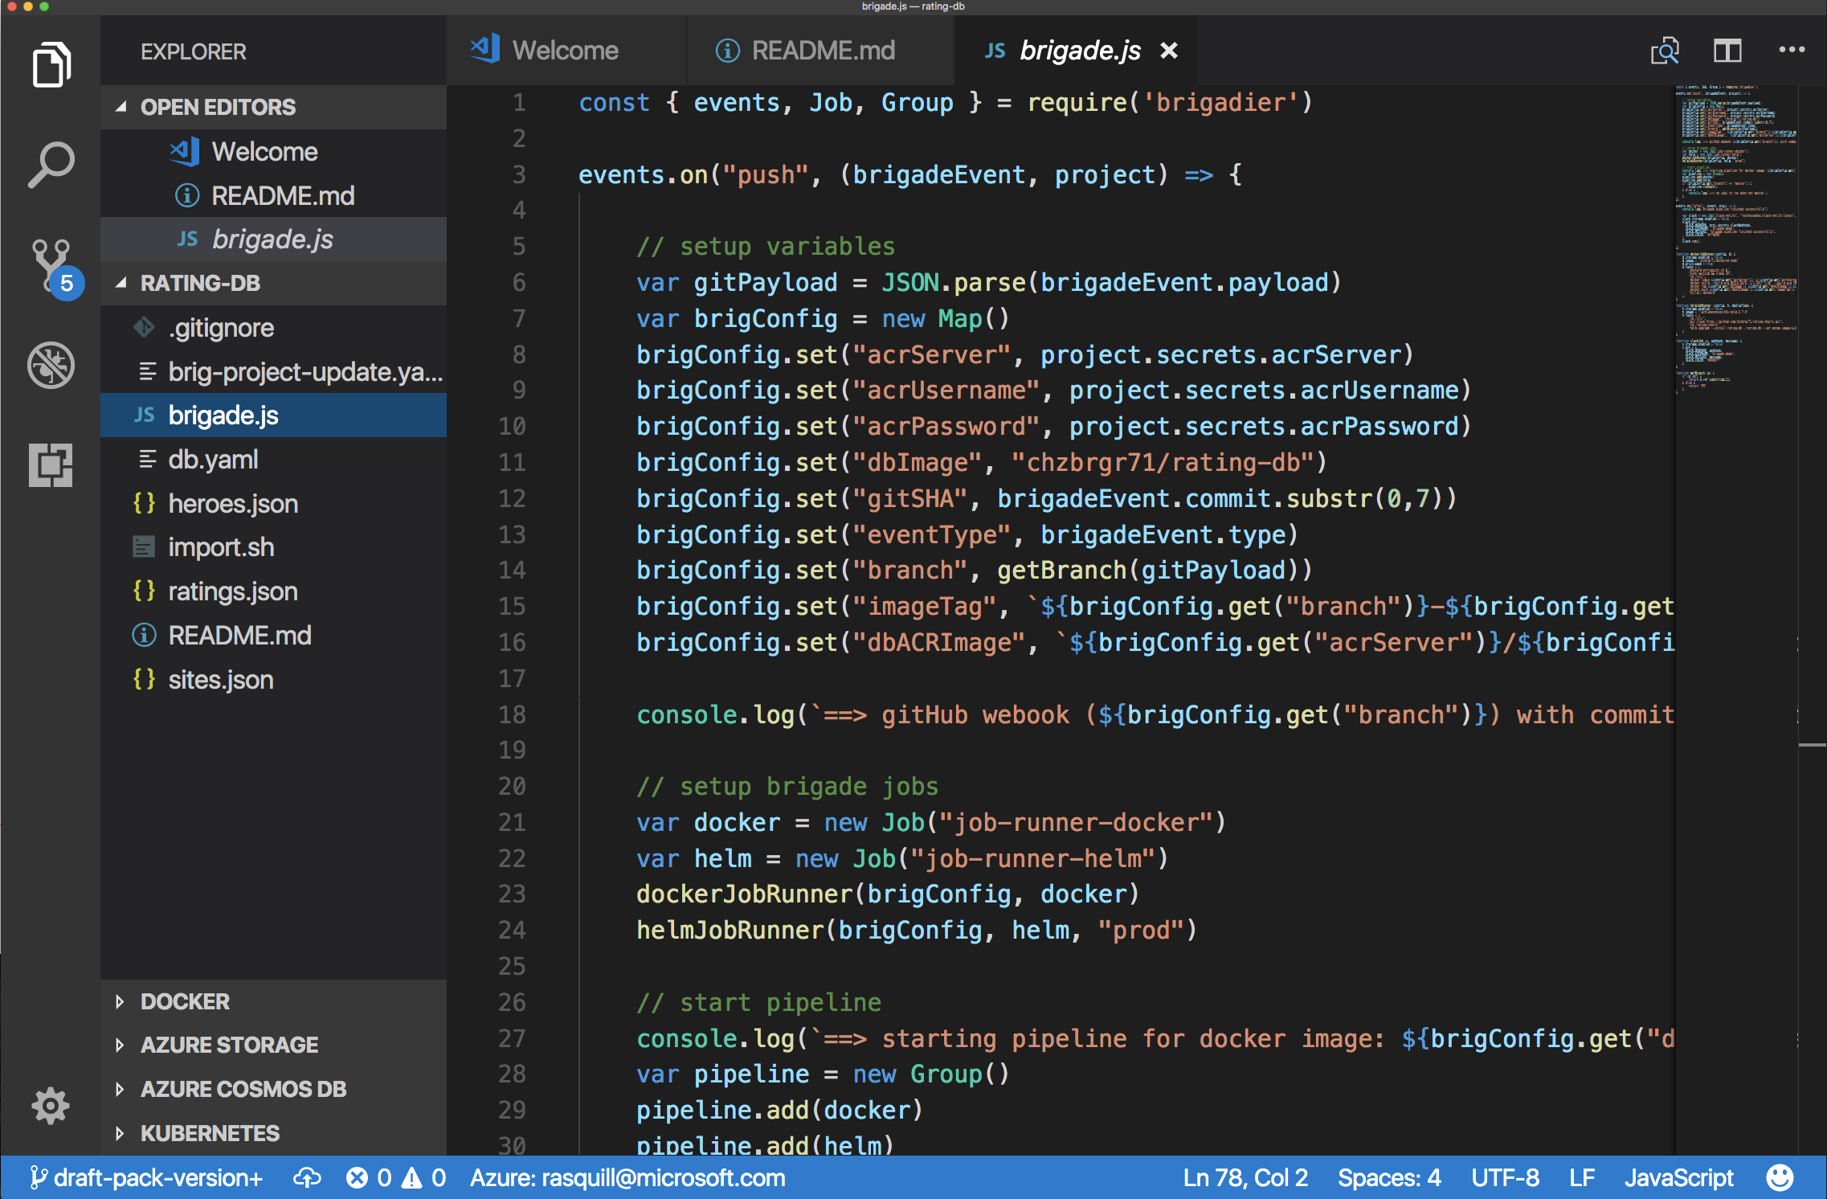
Brigade
Azure Kubernetes Service (AKS)
Brigade in action
Azure Container Instances (ACI)
Azure Container Registry
Open Service Broker API (OSBA)
Release Automation Tools

Slide 63
Kashti
Azure Kubernetes Service (AKS)
A simple UI to display build results and logs
Azure Container Instances (ACI)
Azure Container Registry
Simple visualizations
A web dashboard for Brigade, helping to easily visualize and inspect your Brigade builds
Driving deep insights
Make Brigade DevOps workflows— projects, scripts, and jobs—and their events visible instantly
Open Service Broker API (OSBA)
Release Automation Tools

Slide 64
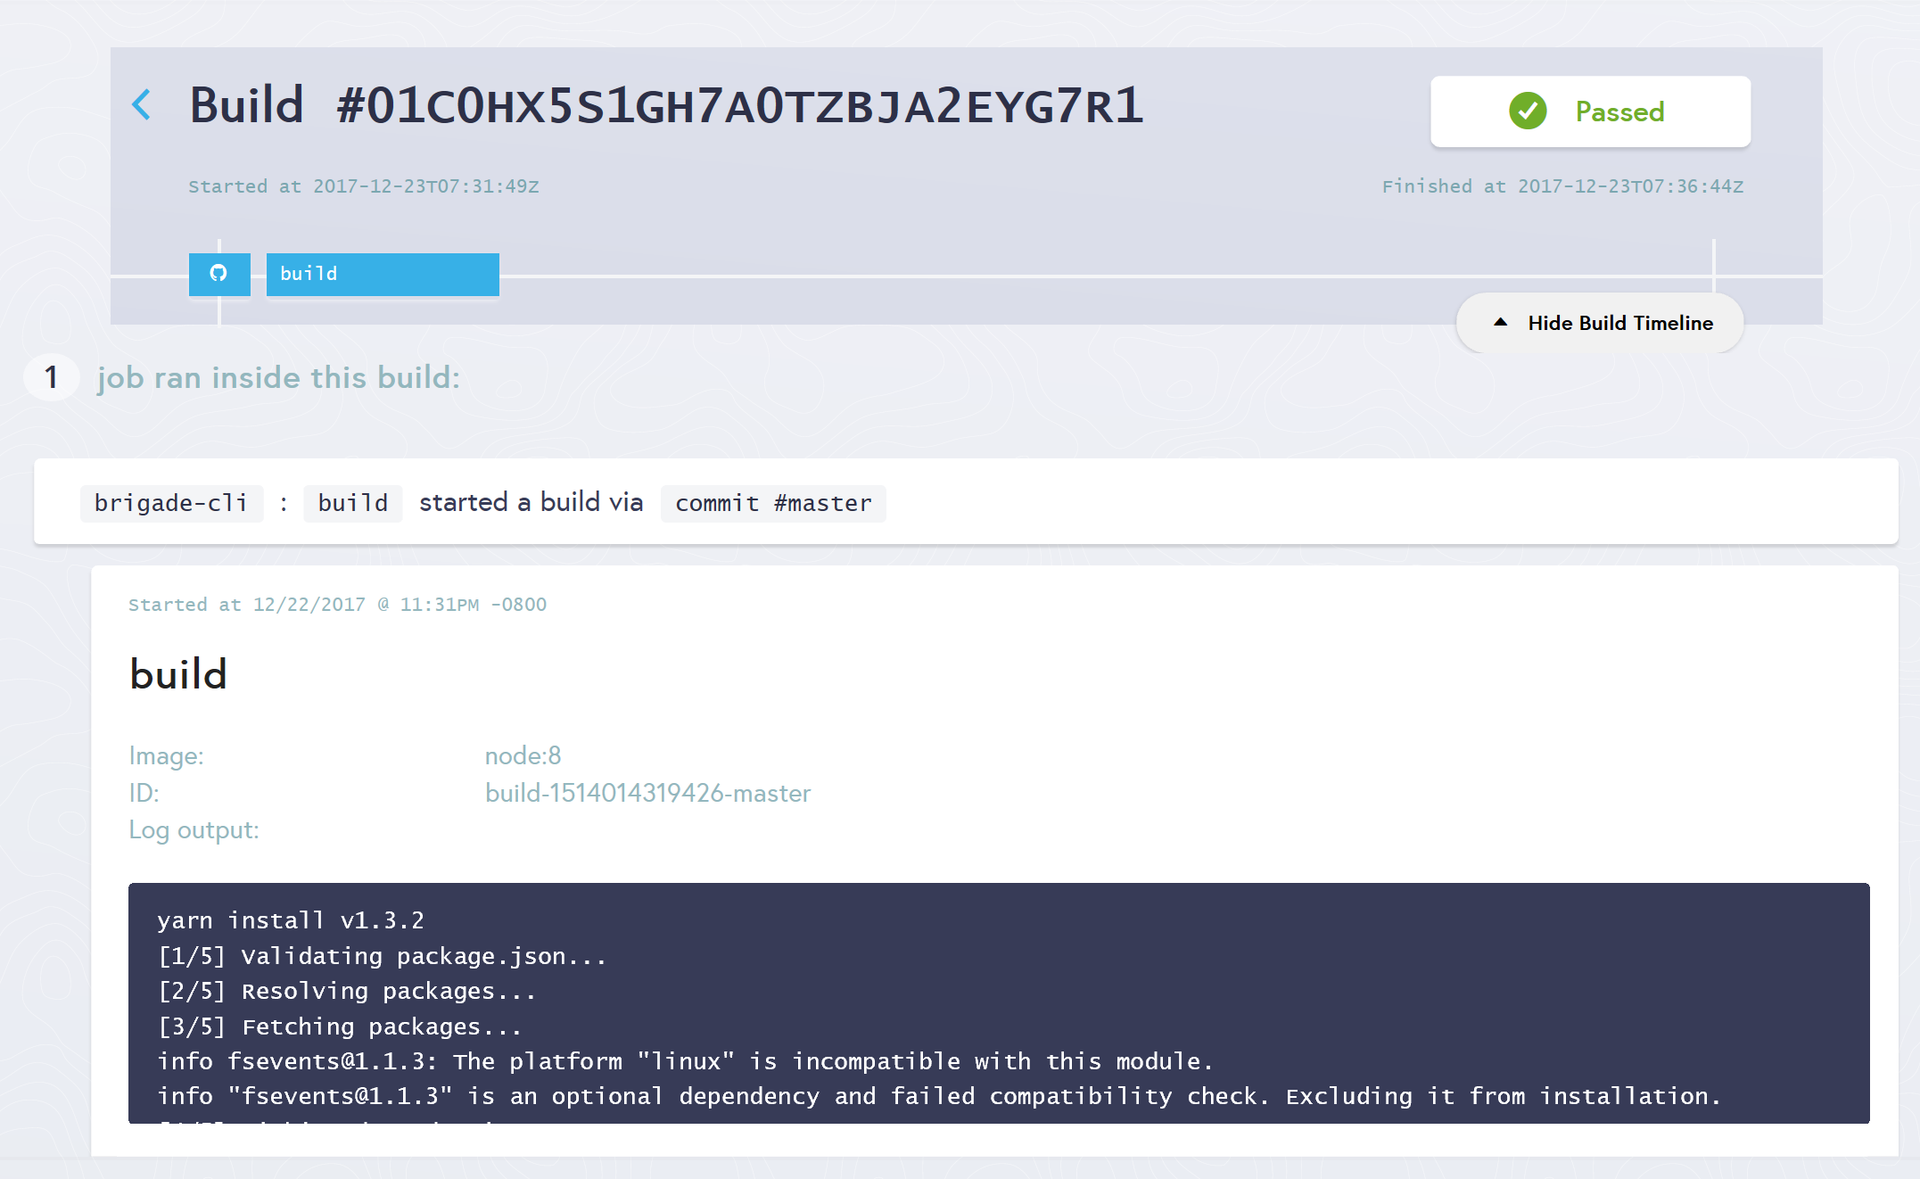
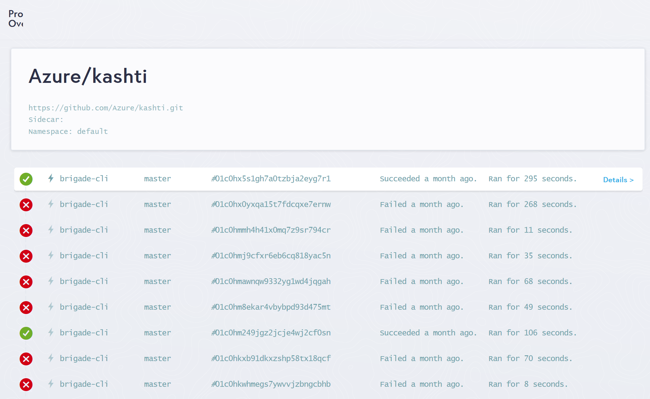
Kashti
Azure Kubernetes Service (AKS)
Dashboards for Brigade pipelines
Azure Container Instances (ACI)
Azure Container Registry
Open Service Broker API (OSBA)
Builds dashboard
Events log
Release Automation Tools

Slide 65

Open source community
Azure Container Registry
Open source community
Azure Kubernetes Service (AKS)
Release automation tools
Containers 101
Azure container technology
Open Service Broker for Azure (OSBA)
Container orchestration
Azure Container Instances (ACI)

Slide 66

Community culture
Open source container code contributions
Numerous open source project builds
Open source community leadership

Slide 67
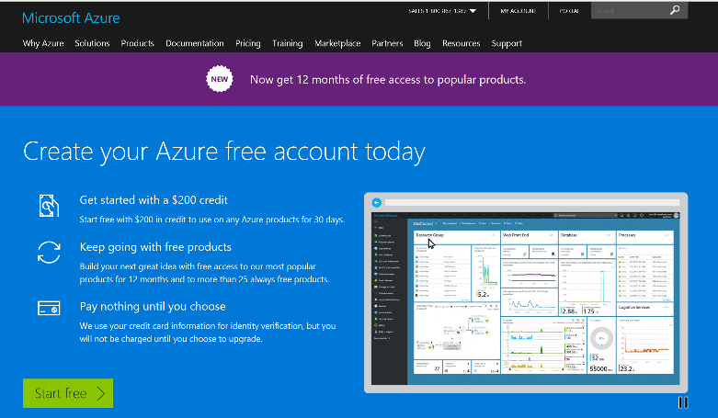
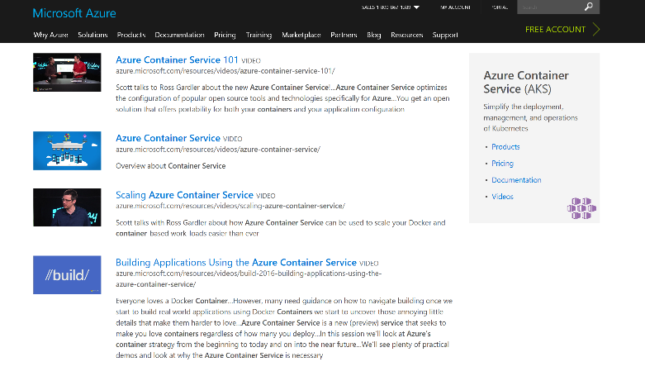
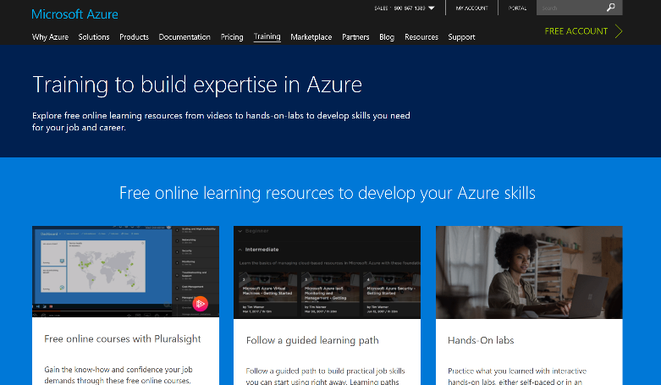
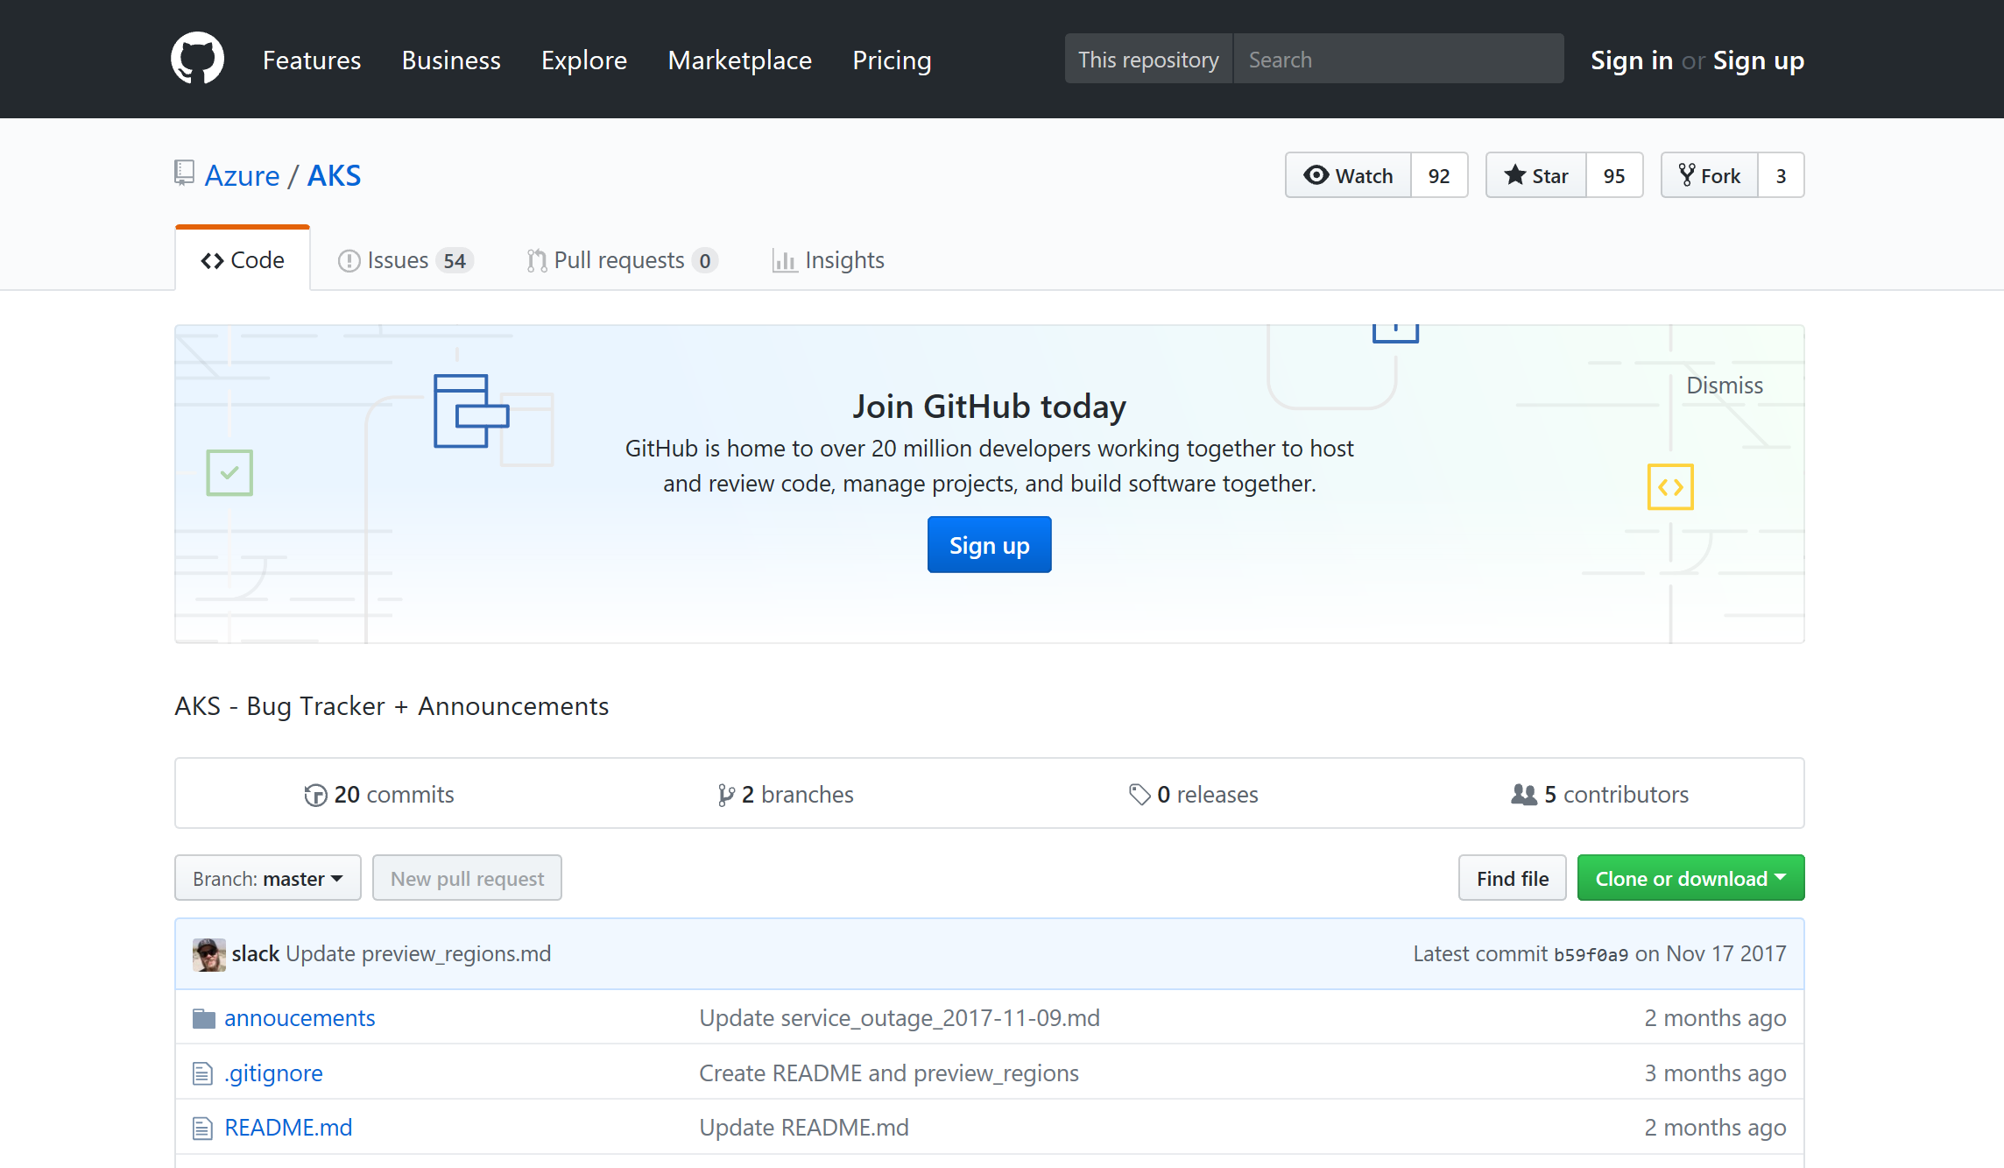
Azure container resources
Azure Kubernetes Service (AKS)
Azure Container Instances (ACI)
Azure Container Registry
OSBA announcement blog
Draft webpage
Helm webpage
Brigade webpage
Kashti announcement blog
Sign up for a free Azure account
Check out the Azure container videos page
Hone your skills with Azure training
Get the code from GitHub

Slide 68
Rapid-fire Developer Notes

Slide 69
Microservices

Slide 70
microservices ≠ containers
microservices is an architectural design approach
containers are an implementation detail that often helps

Slide 71
Microservices

Slide 72
Microservices Benefits
Independent deployments
Enables continuous delivery
No downtime upgrades
Improved scale and resource utilization per service
Fault isolation
Security isolation
Services can be distributed across multiple servers or environments
Multiple languages / diversity
Smaller, focused teams
Code can be organized around business capabilities
Autonomous developer teams

Slide 73
Microservices – The Hard Part
Deployment is complex
Testing is difficult
Debugging is difficult
Monitoring/Logging is difficult
New service versions must support old/new API contracts
Distributed databases make transactions hard
Cluster and orchestration tools overhead
Distributed services adds more network communication
Increased network hops
Requires failure/recovery code
Need service discovery solution
Advanced DevOps capability: short-term pain for long-term gain

Slide 74
12-Factor Apps
Notes:
Explain the benefits of 12 factor apps without walking through all of them.
Recommended guidelines for good microservices apps

Slide 75
12-Factor Apps (1-5)
Single root repo; don’t share code with another app
Deploy dependent libs with app
No config in code; read from environment vars
Handle unresponsive app dependencies robustly
Strictly separate build, release, & run steps
Build: Builds a version of the code repo & gathers dependencies
Release: Combines build with config ReleaseId (immutable)
Run: Runs app in execution environment
Notes:
Single root repo; don’t share code with another app
Deploy dependent libs with app
No config in code; read from environment vars
Handle unresponsive app dependencies robustly
Strictly separate build, release, & run steps
Build: Builds a version of the code repo & gathers dependencies
Release: Combines build with config à ReleaseId (immutable)
Run: Runs app in execution environment

Slide 76
12-Factor Apps (6-12)
App executes as 1+ stateless process & shares nothing
App listens on ports; avoid using (web) host
Use processes for isolation; multiple for concurrency
Processes can crash/be killed quickly & start fast
Keep dev, staging, & prod environments similar
Log to stdout (dev=console; prod=file & archived)
Deploy & run admin tasks (scripts) as processes
Notes:
App executes as 1+ stateless process & shares nothing
App listens on ports; avoid using (web) host
Use processes for isolation; multiple for concurrency
Processes can crash/be killed quickly & start fast
Keep dev, staging, & prod environments similar
Log to stdout (dev=console; prod=file & archived)
Deploy & run admin tasks (scripts) as processes

Slide 77
Managing Storage and State

Slide 78

Managing State For Containers
Azure
Data Service
Local Storage
Remote Storage
Pod
Pod
Pod
CosmosDB

Slide 79
Kubernetes Concepts

Slide 80
Kubernetes Architecture Components
api-server
etcd
master components
controller-manager
scheduler
* Azure Managed
kubelet
kube-proxy
node components
docker
dns

Slide 81




Pod

Slide 82
pod
pod
rating-api
rating-web
port
3000
port
8080
pod
rating-db
port
27017

Slide 83
Deployment
label
app=heroes-web , tier=web
image
azurecr.io/rating-web:v1
pod
heroes-web-1
port
8080
port
pod
heroes-web-2
port
8080
heroes-web

Slide 84
Deployment
label
app=heroes-web, tier=web
image
azurecr.io/rating-web:v1
pod
Service
heroes-web-1
port
8080
Heroes-web
pod
port
selector
app=heroes-web
heroes-web-2
port
8080:8080
port
8080
IP
10.0.2.20
heroes-web

Slide 85
Scaling Applications

Slide 86
Scaling Pods => Application Level
Pod
Pod
Pod
Pod
Pod
Pod

Slide 87
Scaling Host => Infrastructure Level
Pod
Pod
Pod
Pod
Pod
Pod
Pod
Pod

Slide 88
Scaling the ACS Cluster

Slide 89
Monitoring

Slide 90
Monitoring is too often static in nature

Slide 91
Need to monitor for dynamic environments
Pod
Pod
Pod
Pod
Pod
Pod
Pod
Pod
Pod
Pod
Pod
Pod
Pod
Pod
Pod
Pod

Slide 92
Application Health and Readiness
Kubelets on workers use liveness and readiness probes to know when to restart a container or start directing traffic
Liveness check: when to restart
Readiness check: when to forward Service traffic to a pod
Notes:
Look at liveness
Look at readiness

Slide 93
Monitoring: What indicators matter in Kubernetes
Cluster health: total number of nodes, pods, etc
Node health: available compute resources, health
Application health
Tooling Examples
Datadog
Prometheus
InfluxData
Cloud-specific: OMS (Azure), CloudWatch (AWS)
Notes:
https://docs.datadoghq.com/integrations/kubernetes/

Slide 94
Logging
Pod logs: applications must log to standard out!
Cluster-wide event logs
Logging forwarder solutions
fluentd
logstash
Log indexers
OMS Log Analytics
Splunk
ELK stack

Slide 95

Questions?

